Slide 1
Demonstration of SOM weight evolution
Settings:
10 epochs
Euclidean distance
10x10 grid size
Non-toroidal boundary
Starting alpha: 0.9
Starting neighborhood size: 5x5

Slide 2
Training Data
500 samples
Each sample: Three random numbers [0-1]

Slide 3
Training Data
500 samples
Each sample: Three random numbers [0-1]
SOM advantage: Overlay known information

Slide 4
Training Data
500 samples
Each sample: Three random numbers [0-1]
SOM advantage: Overlay known information
Animal names
Algal bloom state

Slide 5
Training Data
500 samples
Each sample: Three random numbers [0-1]
SOM advantage: Overlay known information
Animal names
Algal bloom state
Color: RGB

Slide 6
Training Data
500 samples
Each sample: Three random numbers [0-1]
SOM advantage: Overlay known information
Animal names
Algal bloom state
Color: RGB
R G B
[1,0,0]

Slide 7
Training Data
500 samples
Each sample: Three random numbers [0-1]
SOM advantage: Overlay known information
Animal names
Algal bloom state
Color: RGB
R G B
[1,0,0]
R G B
[0,1,0]

Slide 8
Training Data
500 samples
Each sample: Three random numbers [0-1]
SOM advantage: Overlay known information
Animal names
Algal bloom state
Color: RGB
R G B
[1,0,0]
R G B
[0,1,0]
R G B
[0,0,1]

Slide 9
Training Data
500 samples
Each sample: Three random numbers [0-1]
SOM advantage: Overlay known information
Animal names
Algal bloom state
Color: RGB
R G B
[1,0,0]
R G B
[1,0,1]
R G B
[0,1,0]
R G B
[0,0,1]

Slide 10
Training Data
500 samples
Each sample: Three random numbers [0-1]
SOM advantage: Overlay known information
Animal names
Algal bloom state
Color: RGB
R G B
[1,0,0]
R G B
[0.5,0,0.5]
R G B
[0,1,0]
R G B
[0,0,1]

Slide 11
Training Data
500 samples
Each sample: Three random numbers [0-1]
SOM advantage: Overlay known information
Animal names
Algal bloom state
Color: RGB
R G B
[1,0,0]
R G B
[0.2,0.8,0.5]
R G B
[0,1,0]
R G B
[0,0,1]

Slide 12
Feature Planes
Weights 10x10x3

Slide 13
Feature Planes
Weights 10x10x3
One “plane” for {R,G,B}

Slide 14
Feature Planes
Weights 10x10x3
One “plane” for {R,G,B}
Plot heatmap of each “plane”

Slide 15
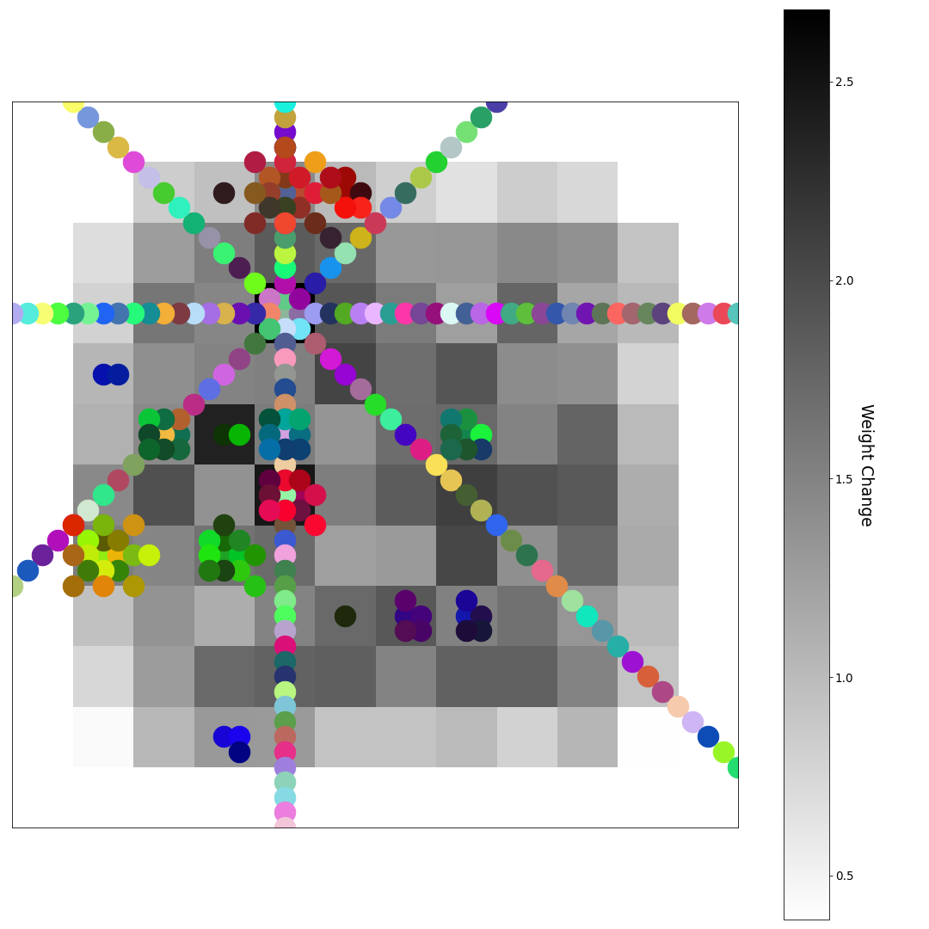
After 0 Epochs (random weights)
0 Epochs (random weights)
U-matrix
U-matrix

Slide 16
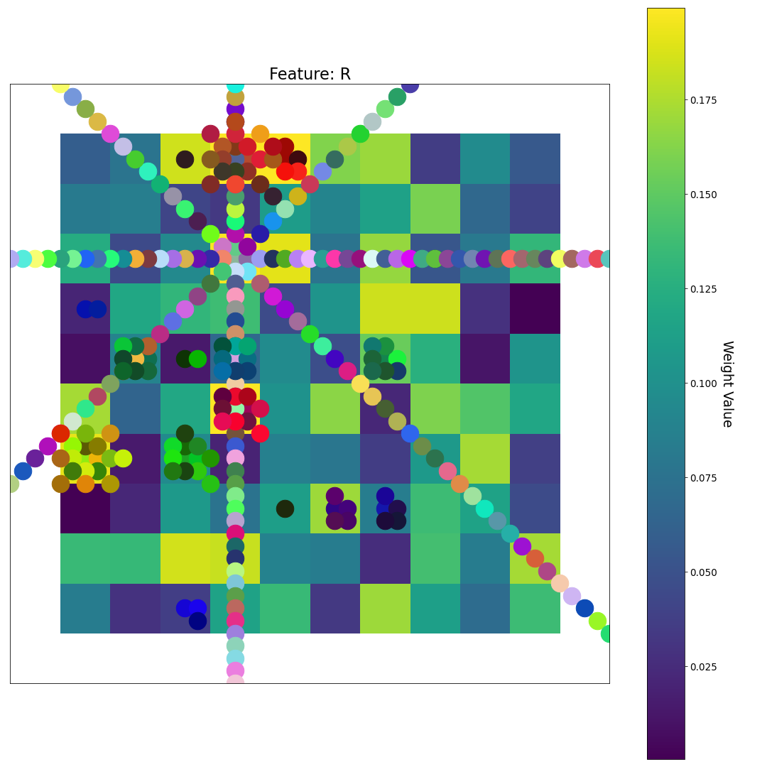
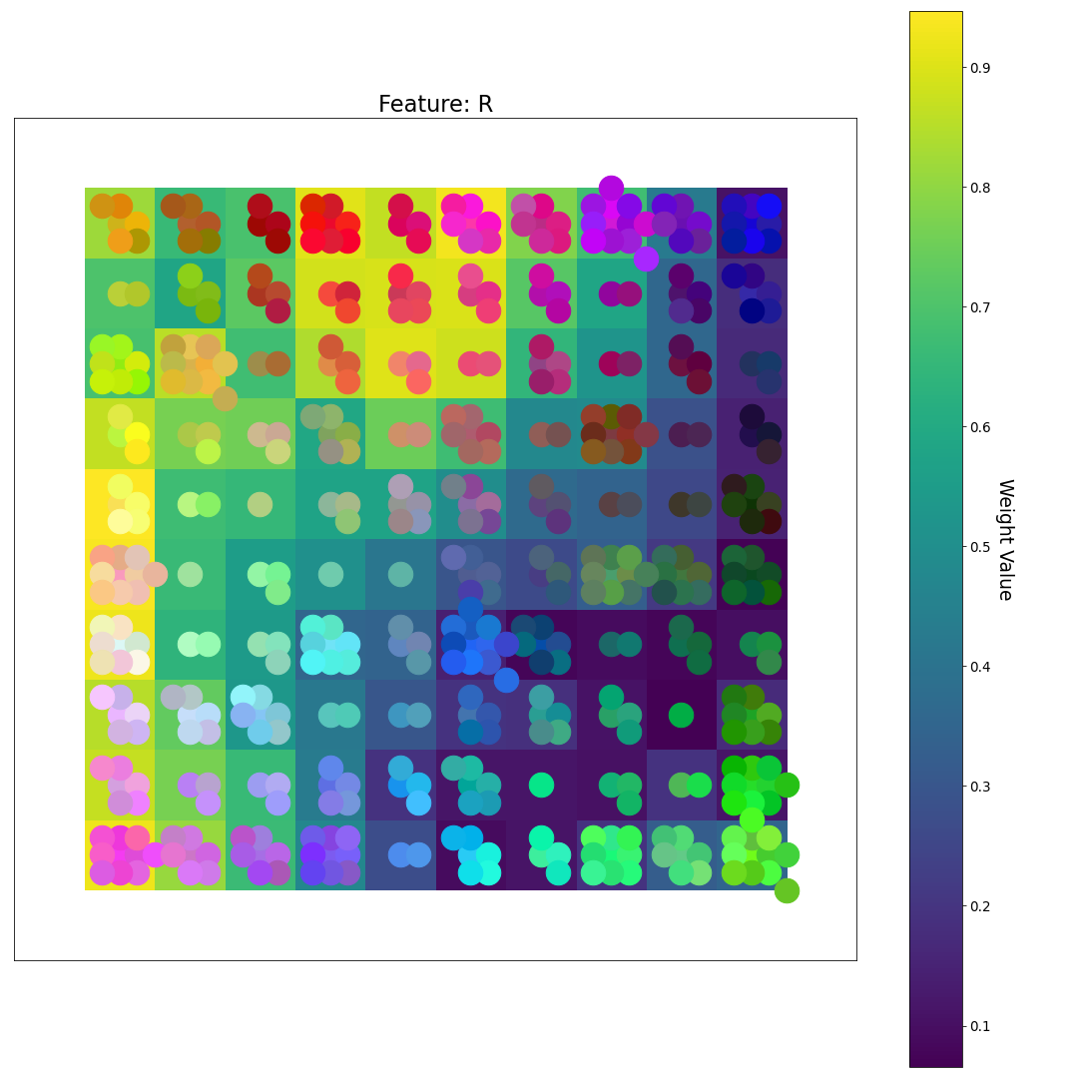
0 Epochs (random weights)
R
U-matrix
Feature Plane
(RED)
Feature Plane Weight Value

Slide 17
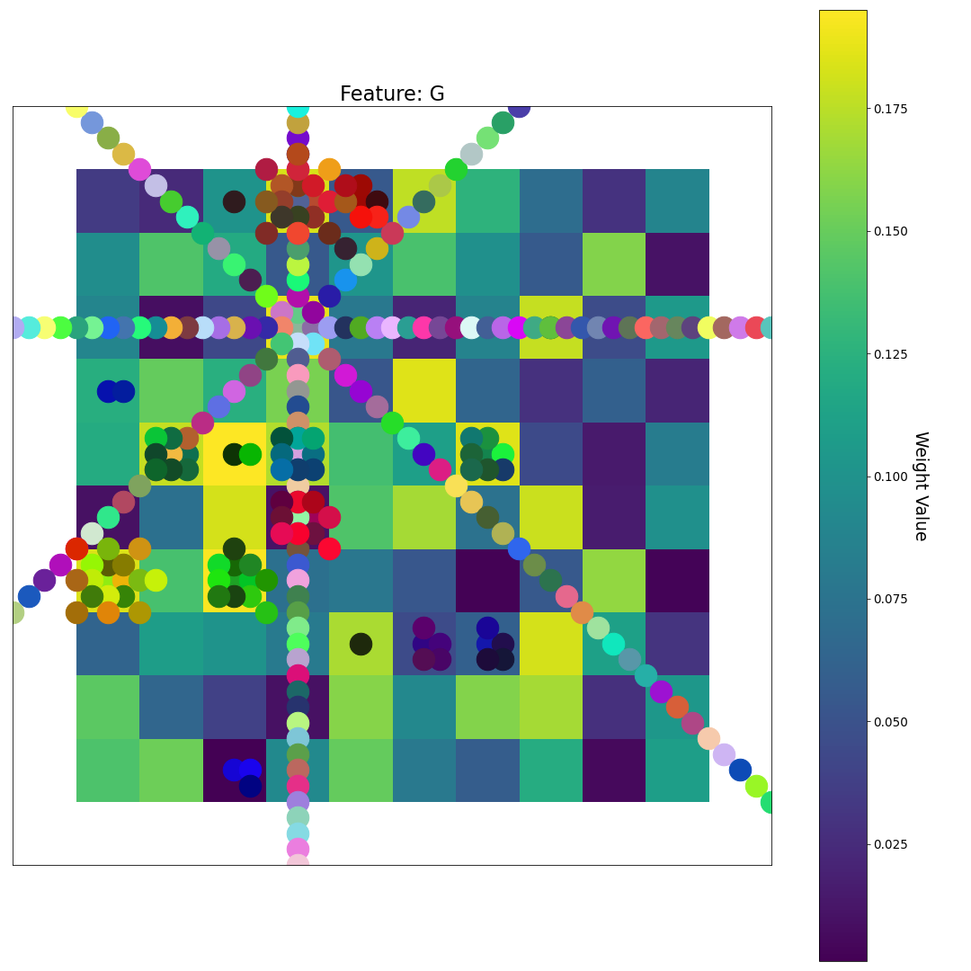
0 Epochs (random weights)
R
U-matrix
Feature Plane
(RED)
G
Feature Plane
(GREEN)
Feature Plane Weight Value

Slide 18
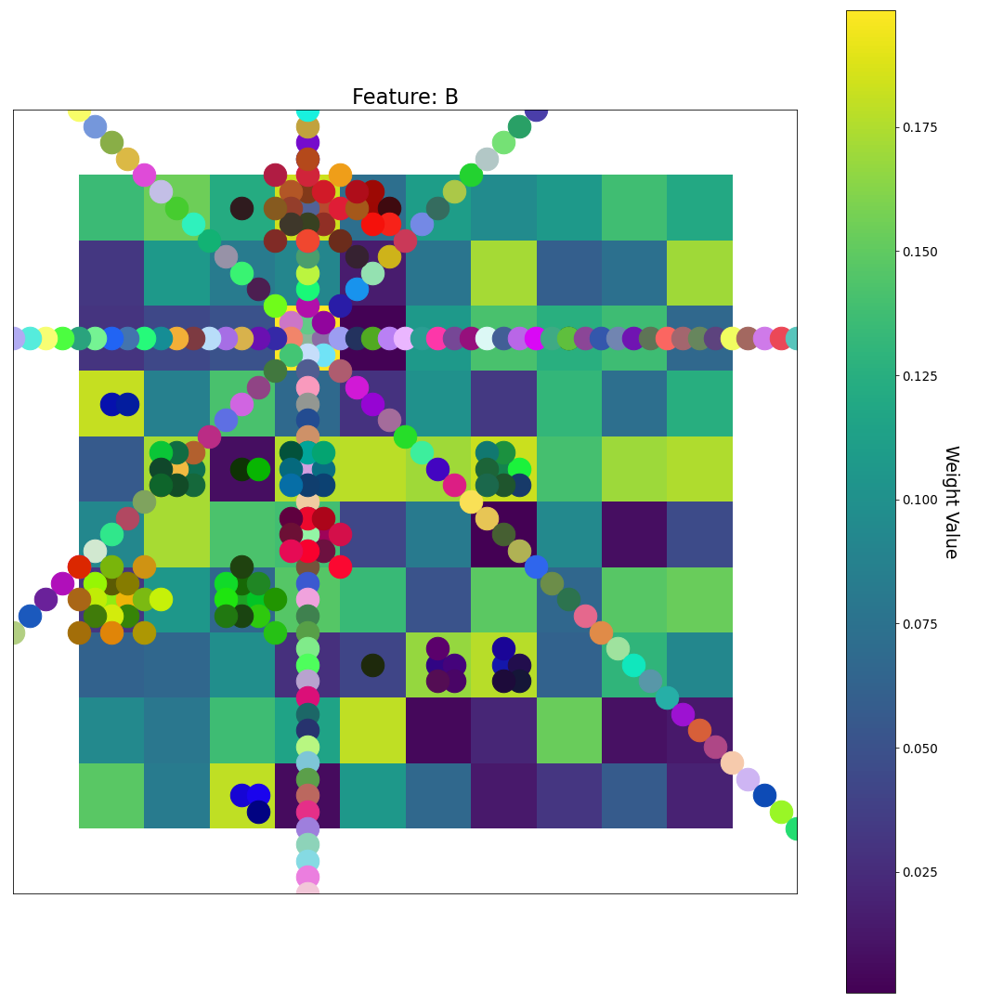
0 Epochs (random weights)
R
U-matrix
Feature Plane
(RED)
G
Feature Plane
(GREEN)
Feature Plane Weight Value
B
Feature Plane
(BLUE)

Slide 19
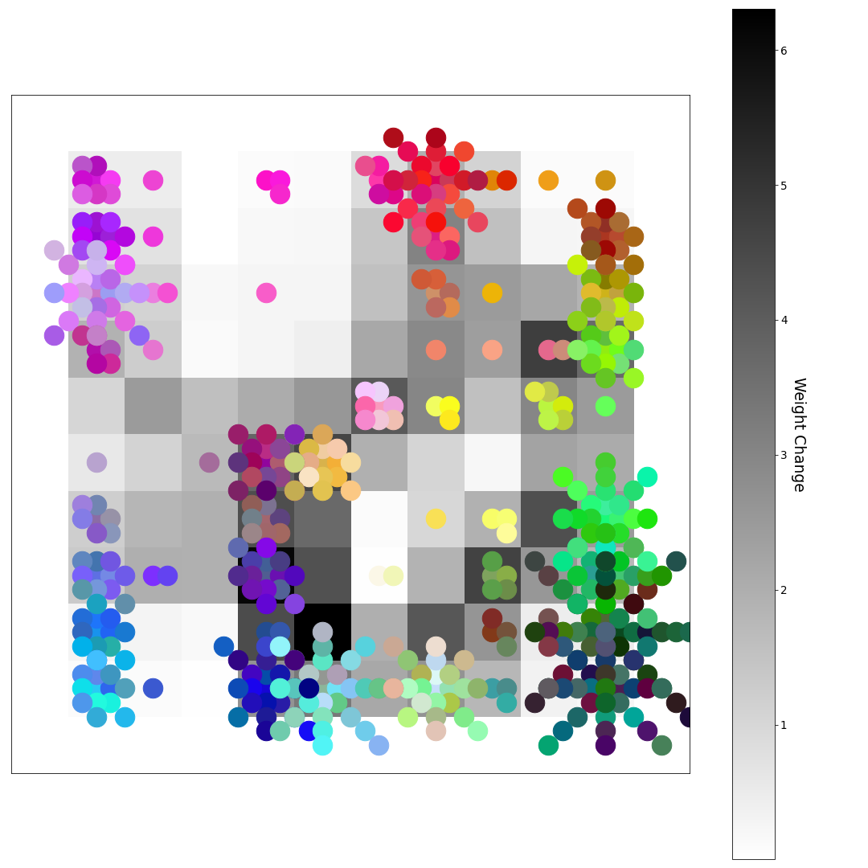
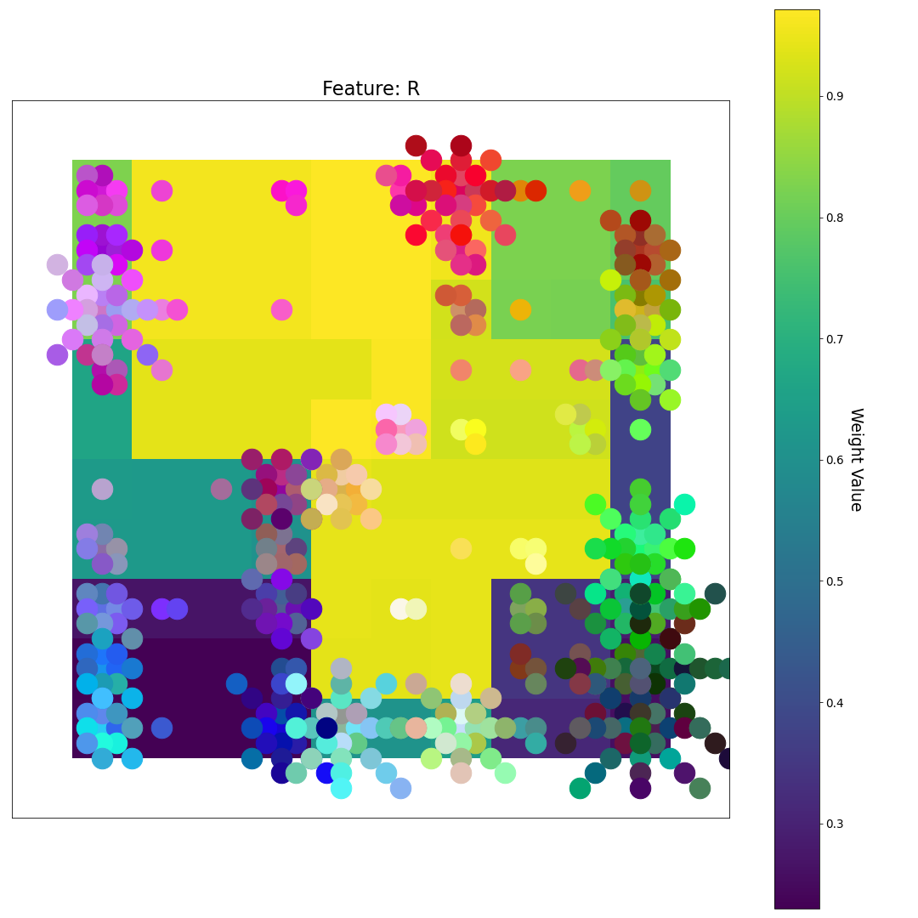
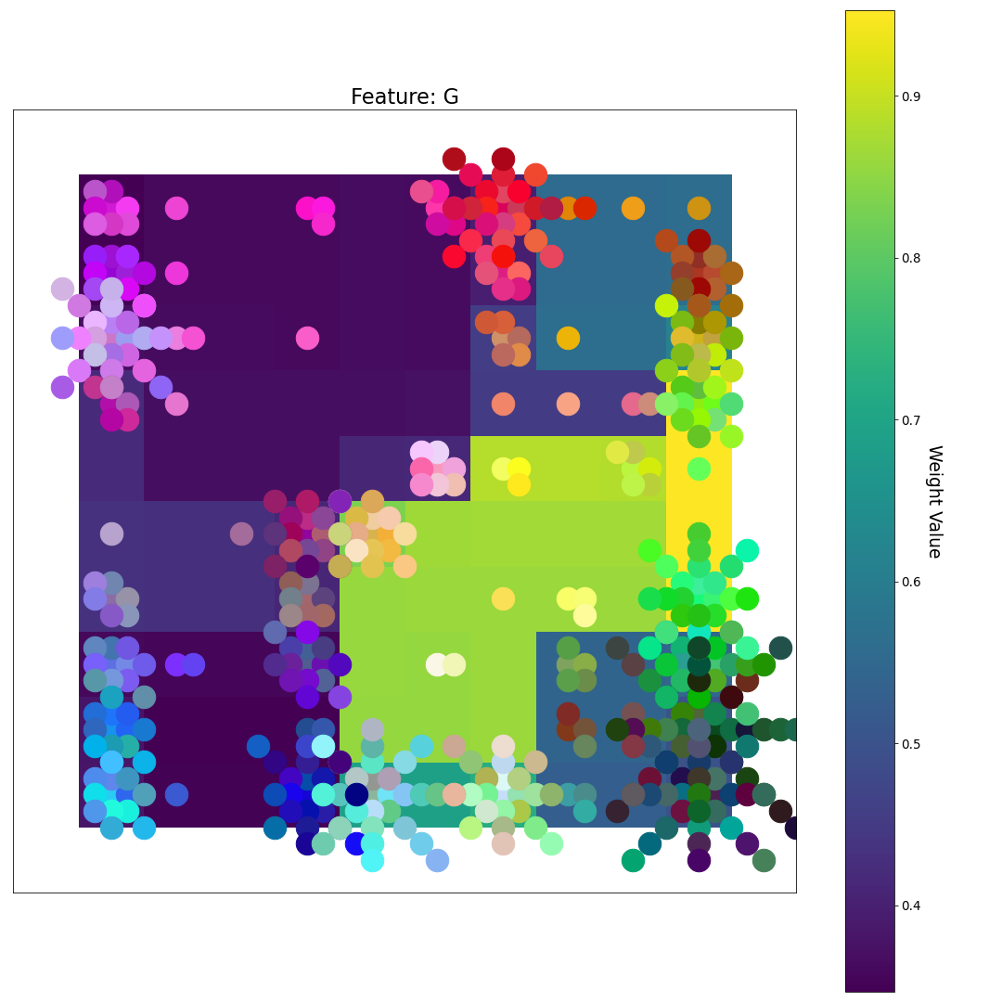
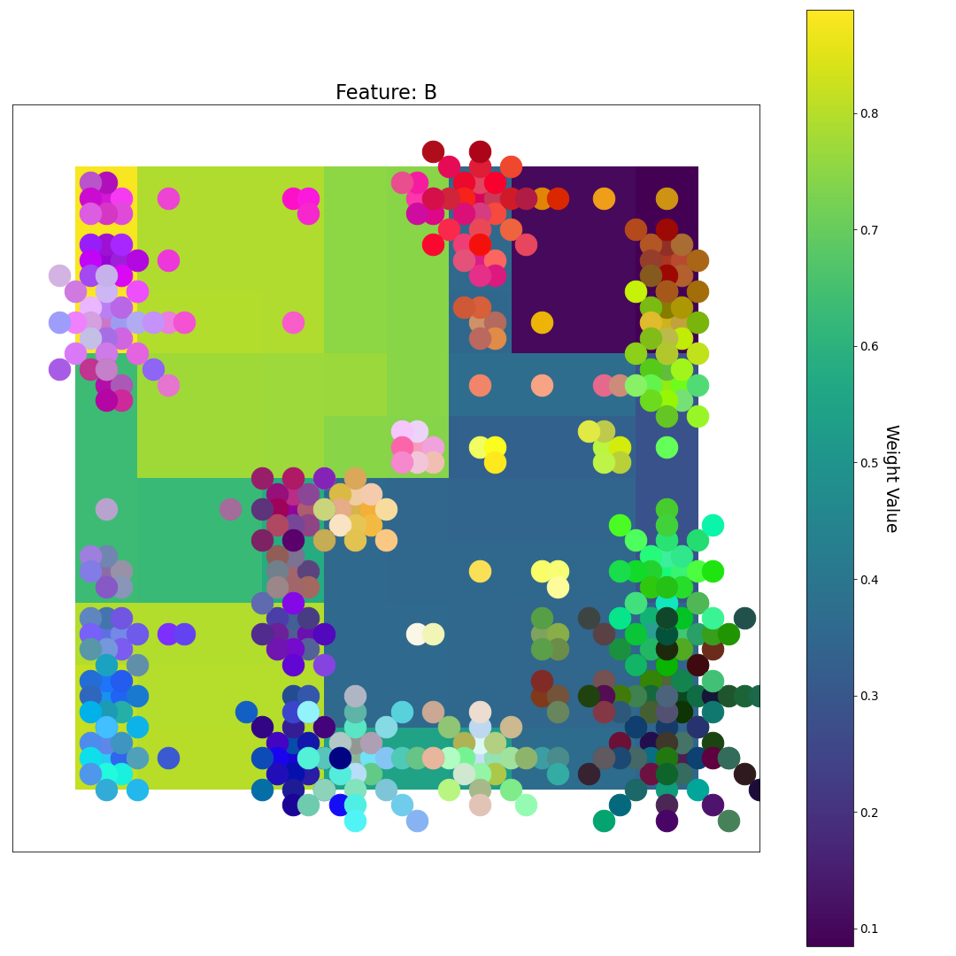
After 1 Epoch
R
What patterns do you see?
U-matrix
G
Feature Plane Weight Value
B

Slide 20
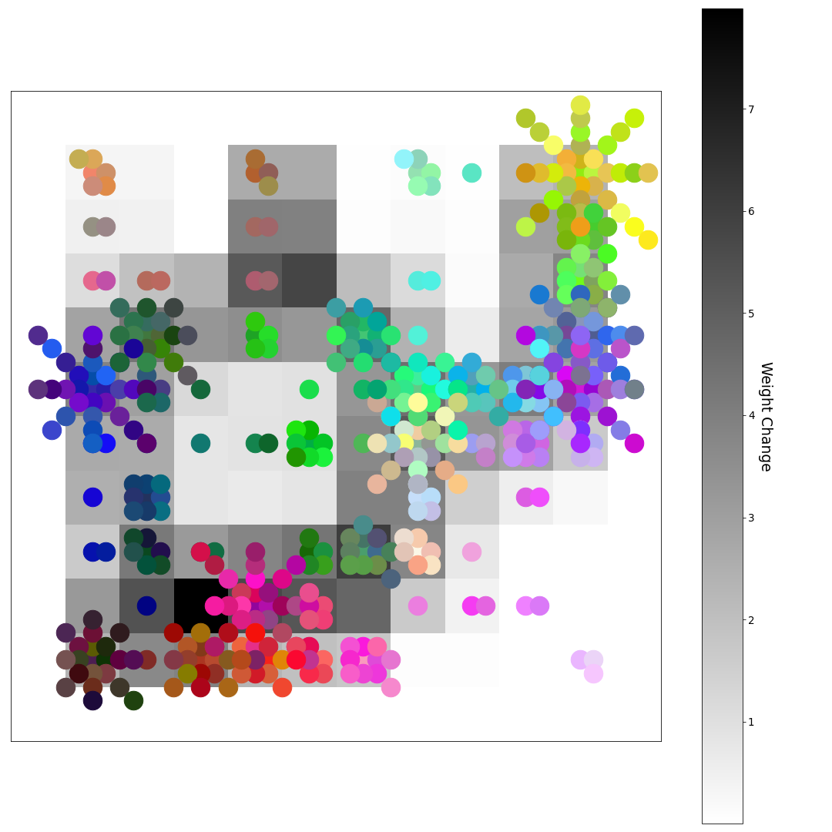
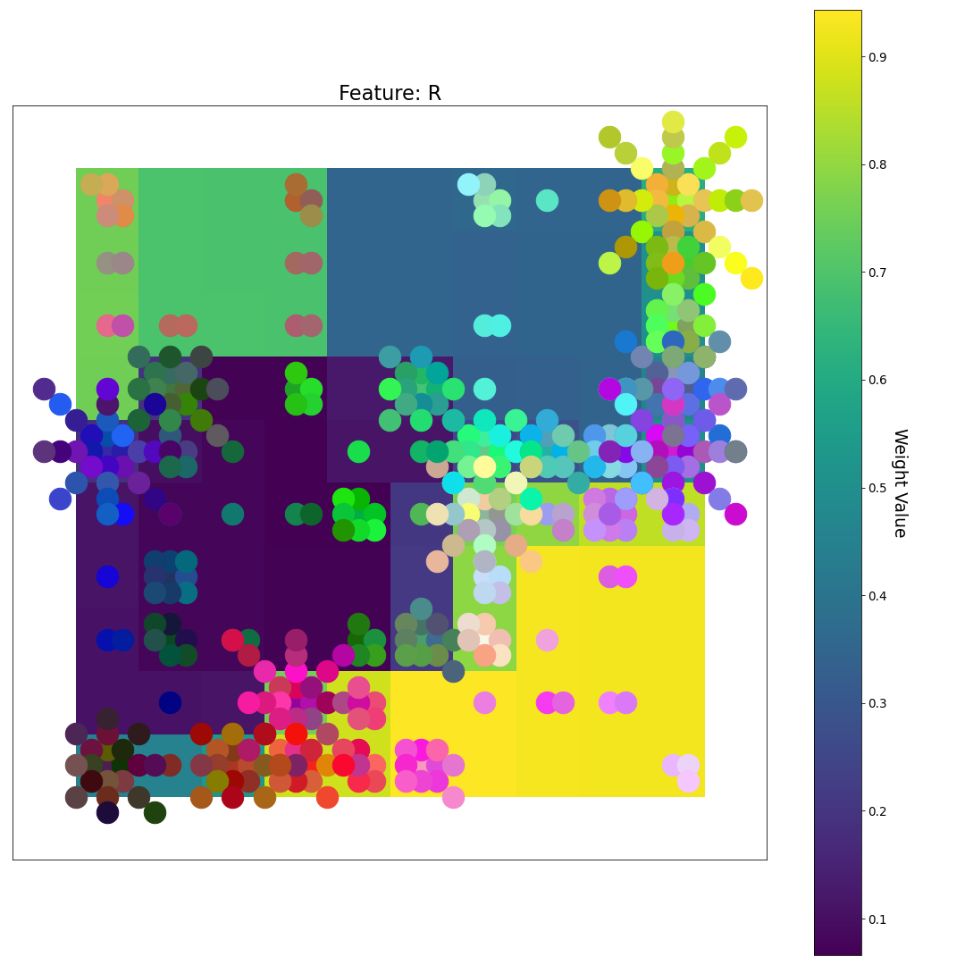
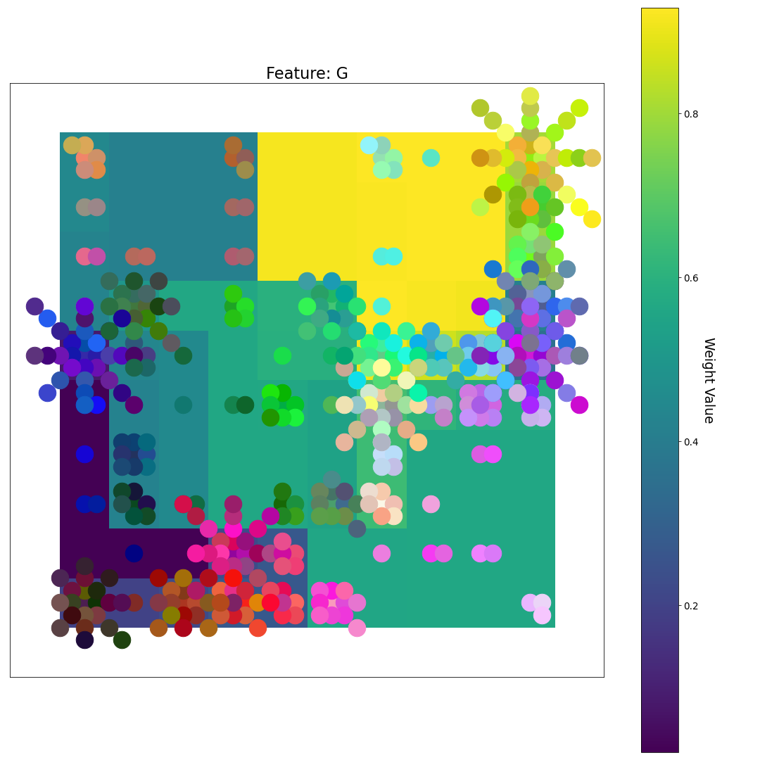
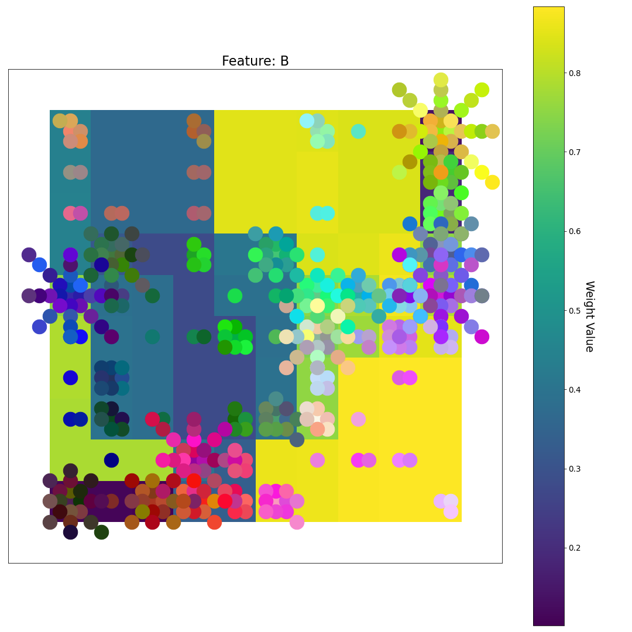
After 2 Epochs
R
What do you notice now?
U-matrix
G
Feature Plane Weight Value
B

Slide 21
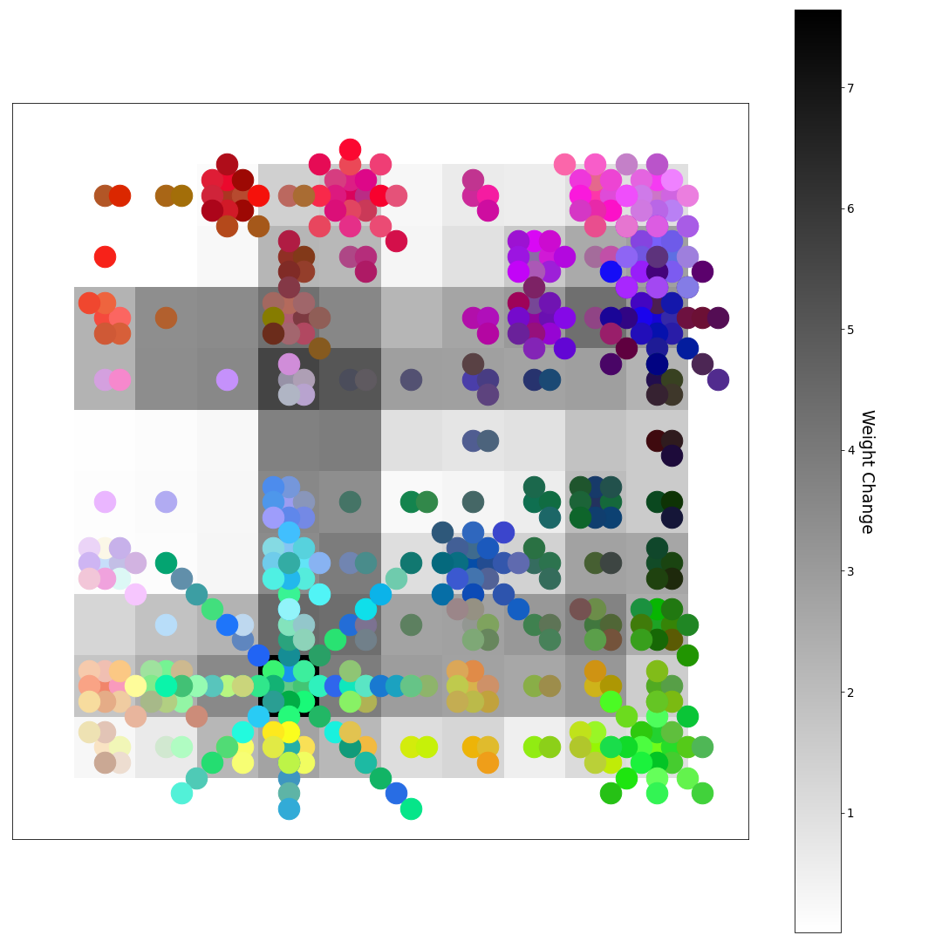
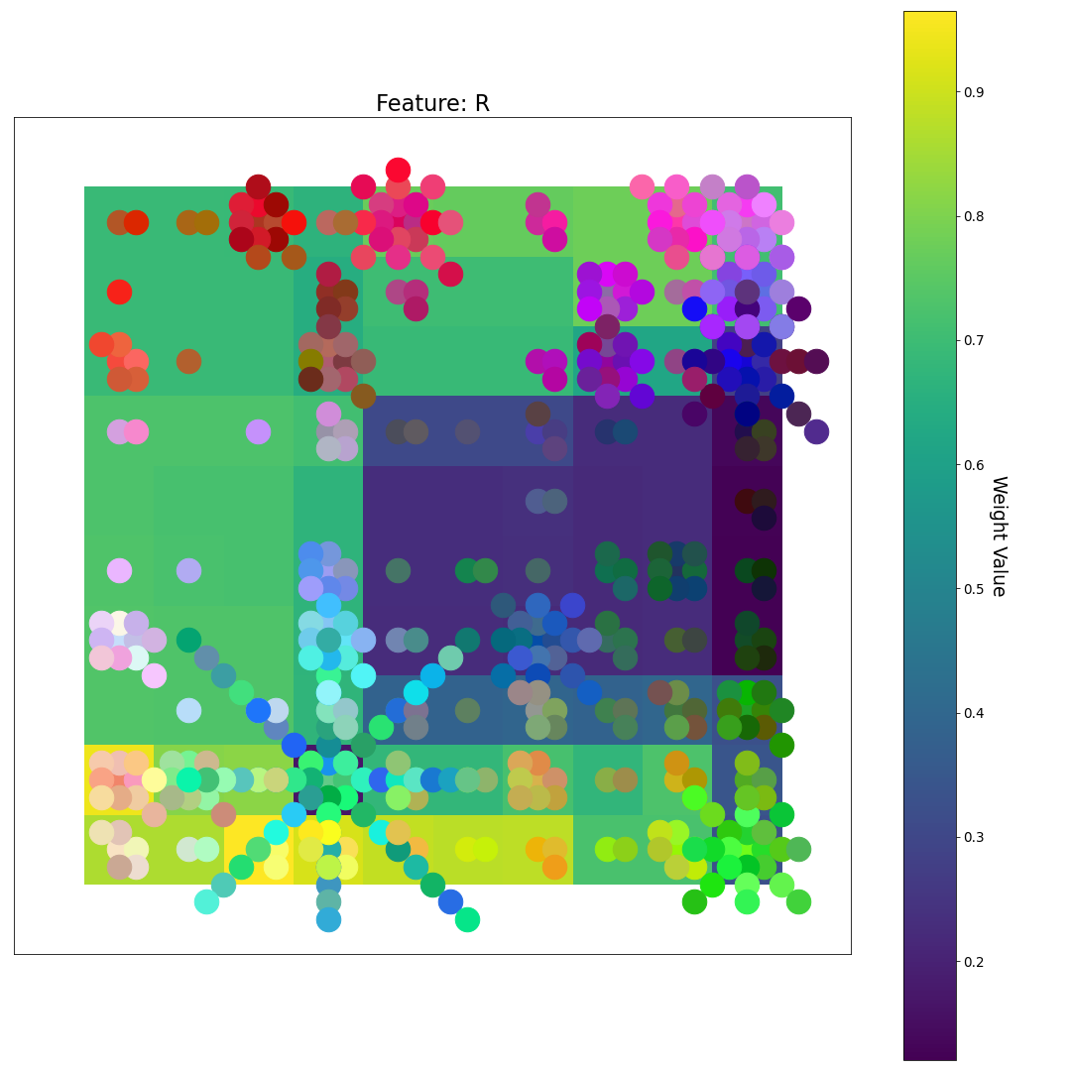
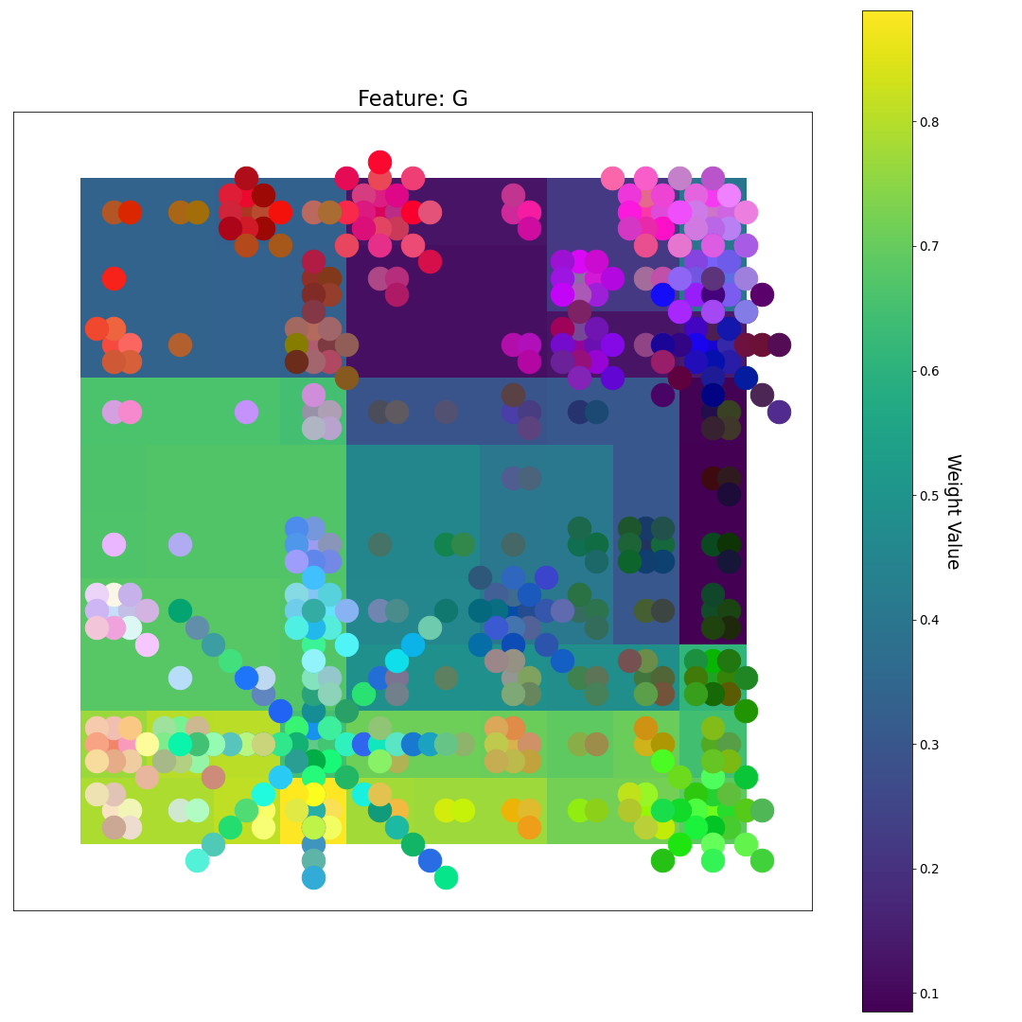
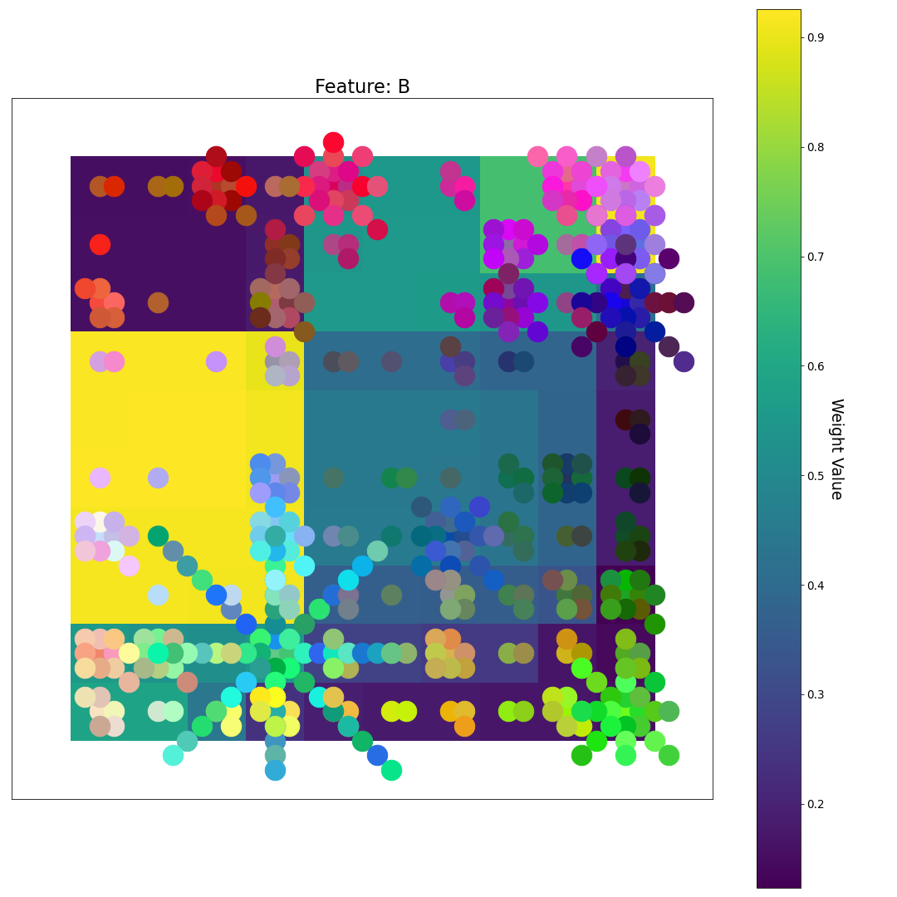
After 3 Epochs
R
U-matrix
G
Feature Plane Weight Value
B

Slide 22
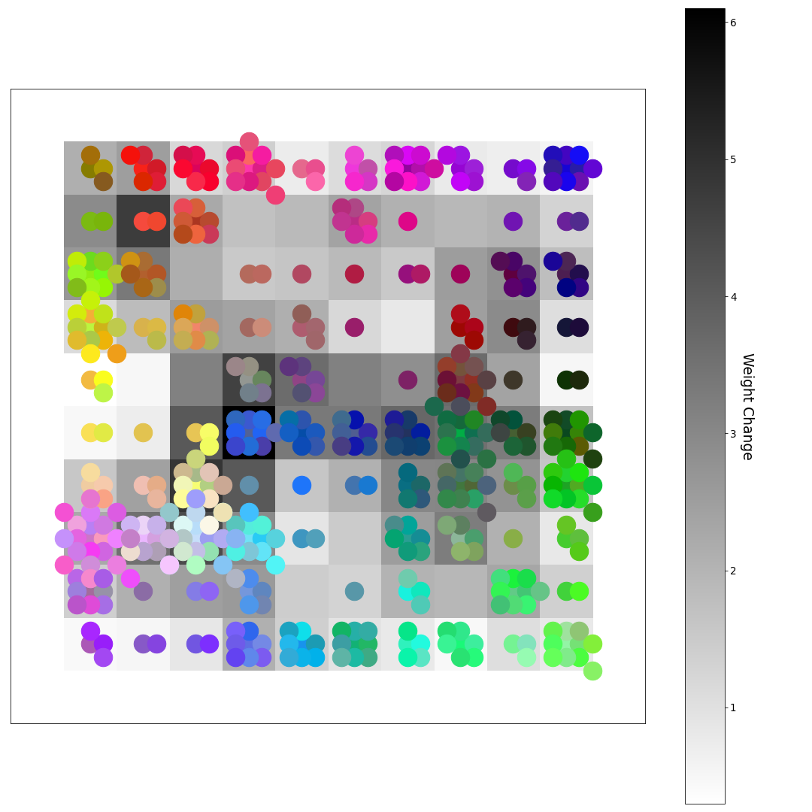
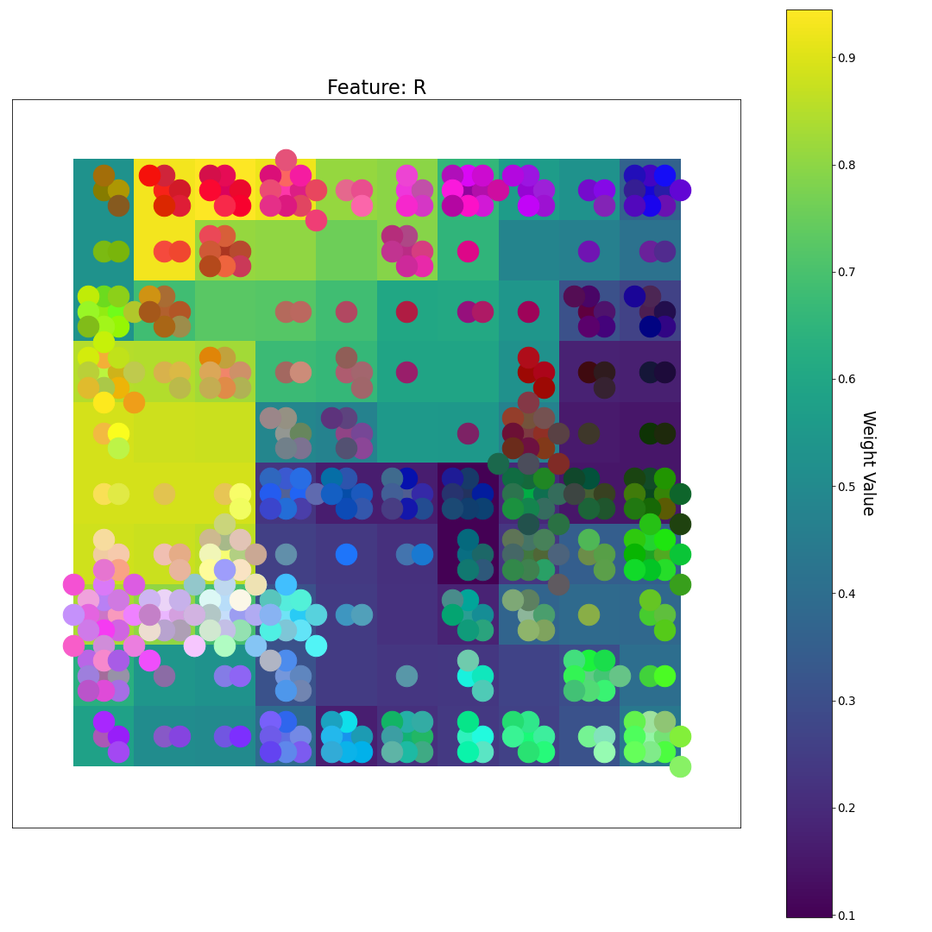
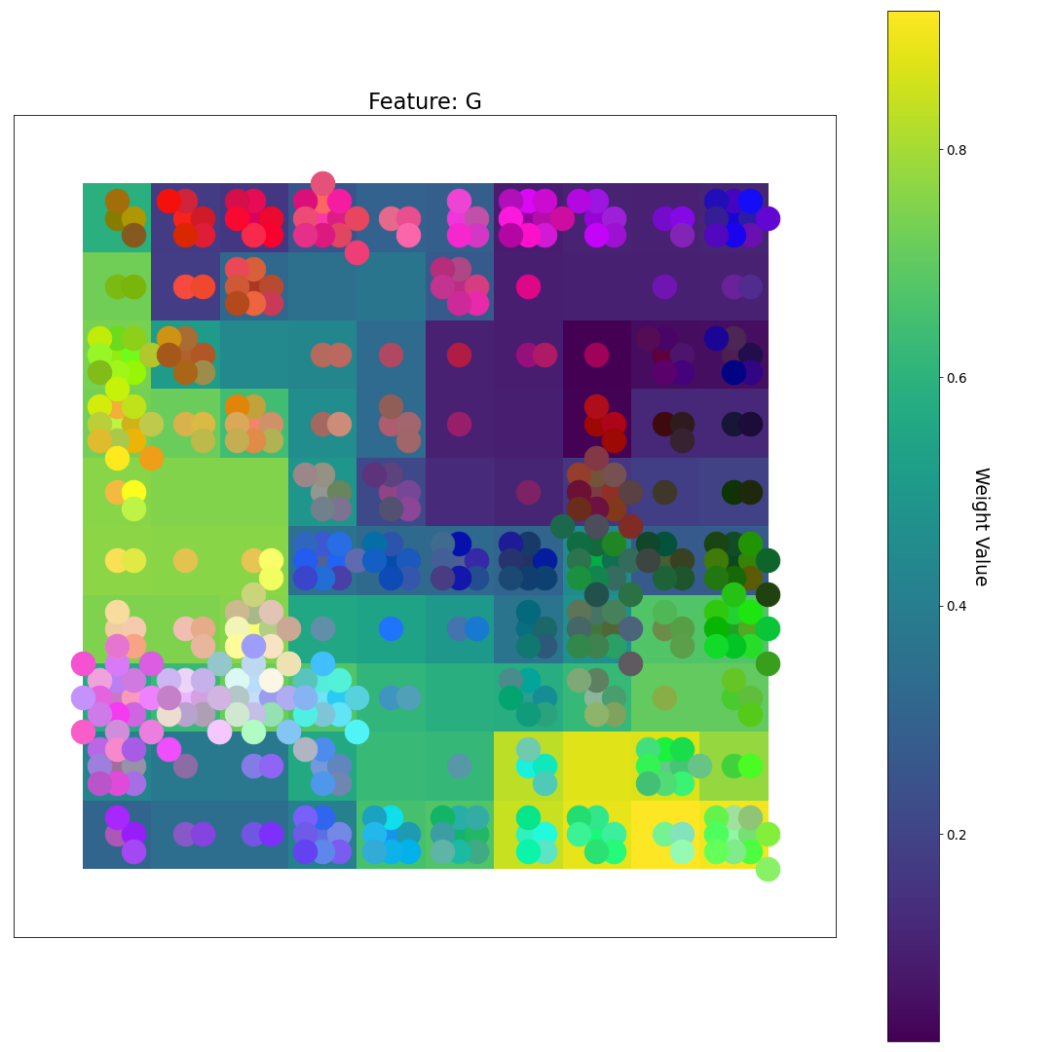
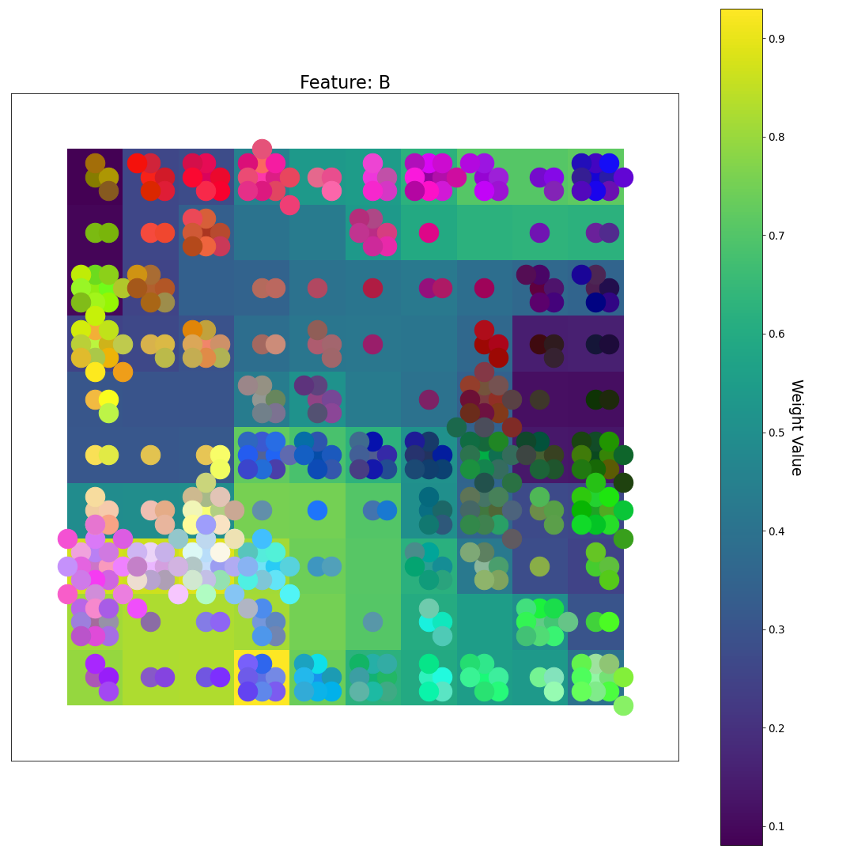
After 4 Epochs
R
What do you notice now?
U-matrix
G
Feature Plane Weight Value
B

Slide 23
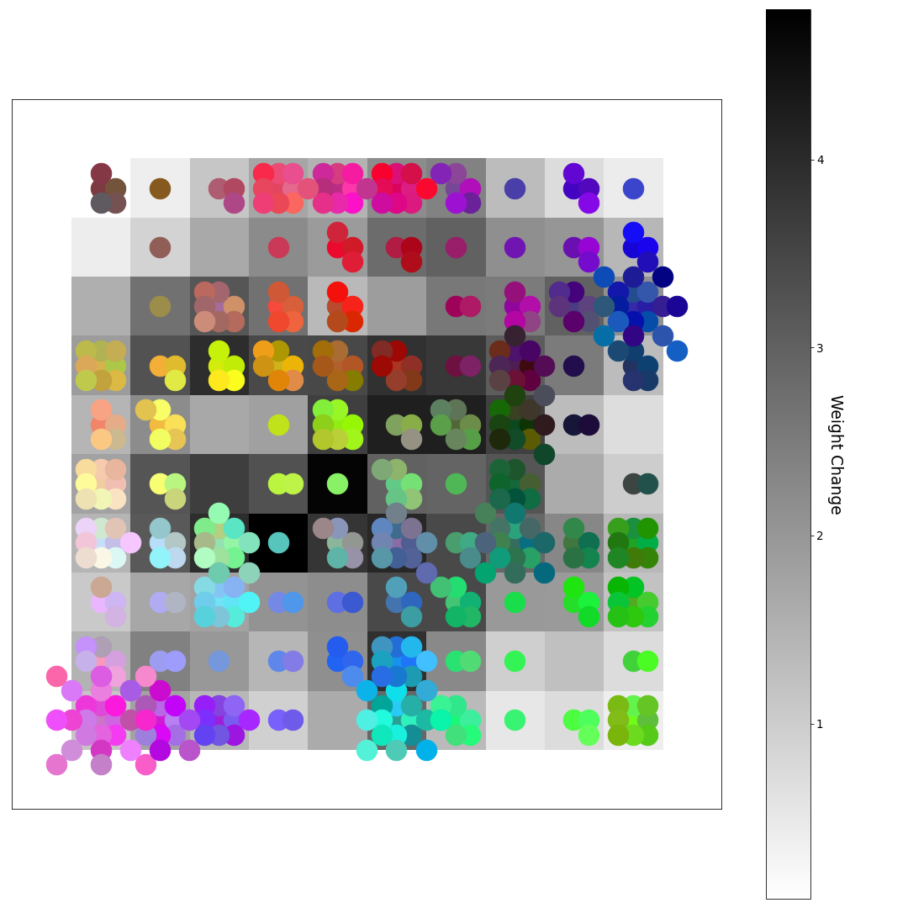
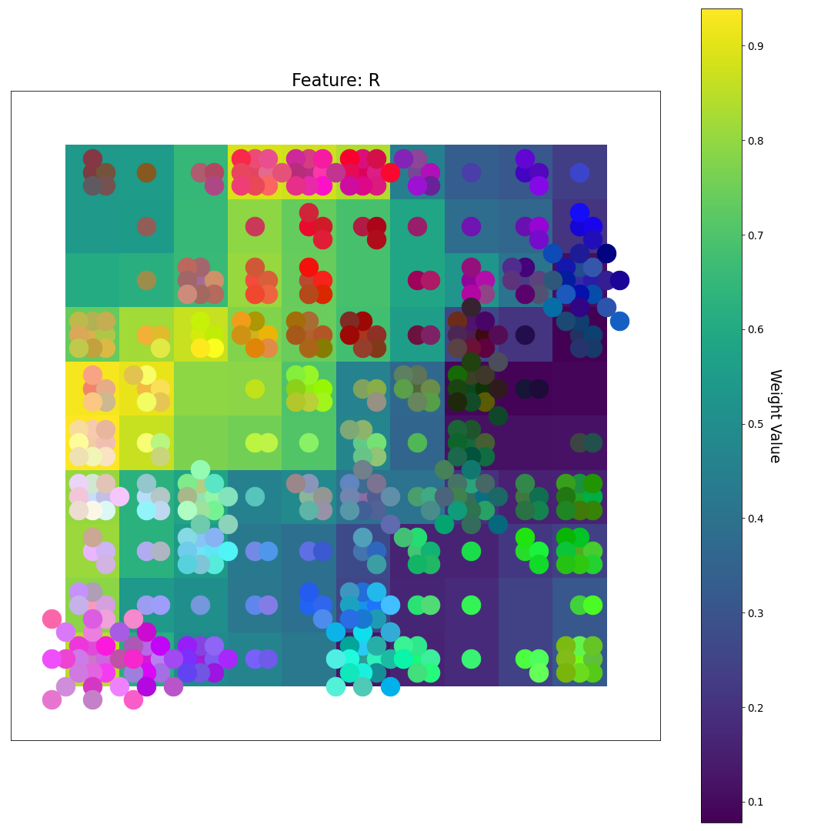
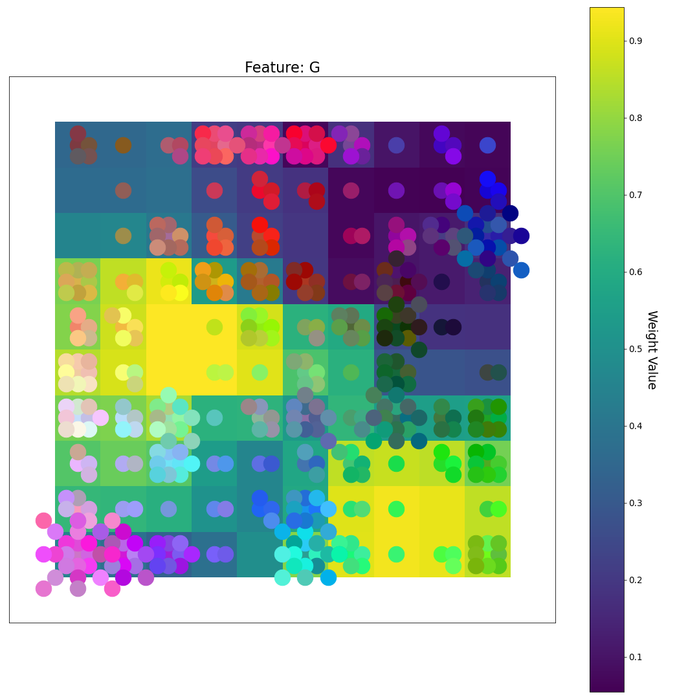
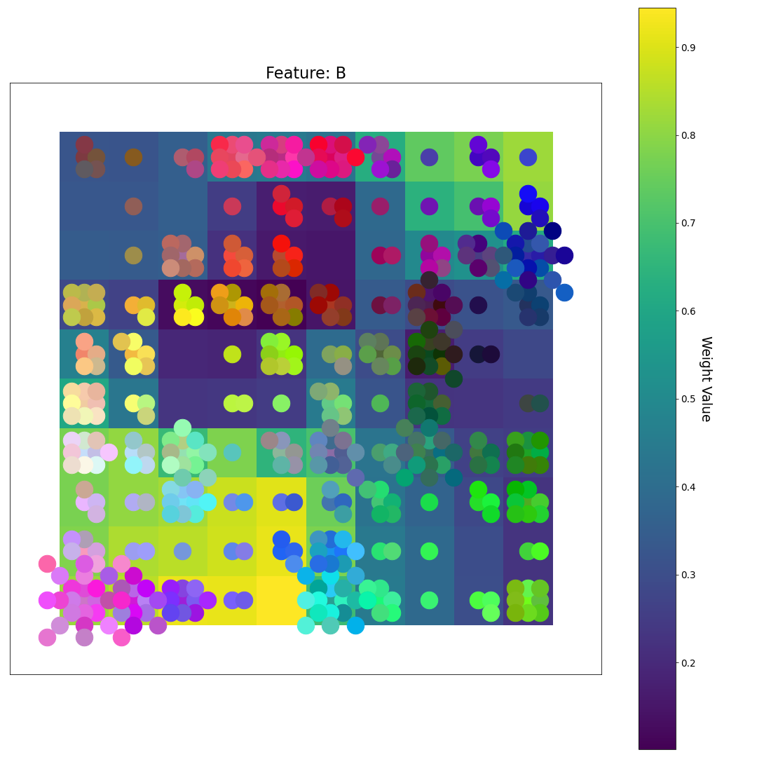
After 5 Epochs
R
U-matrix
G
Feature Plane Weight Value
B

Slide 24
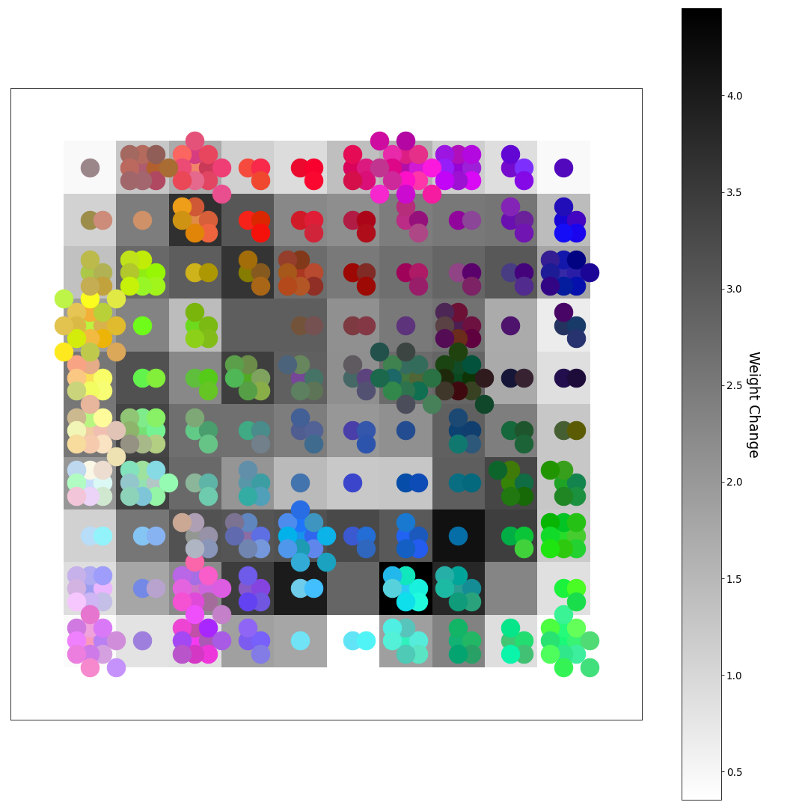
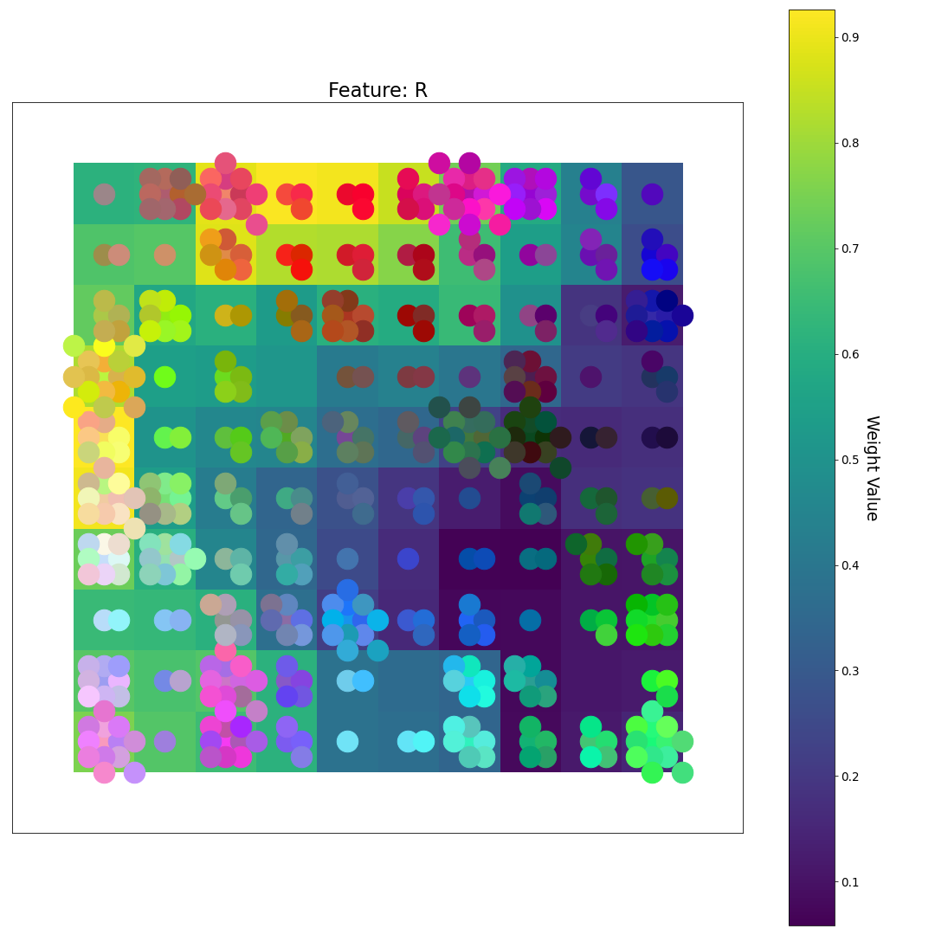
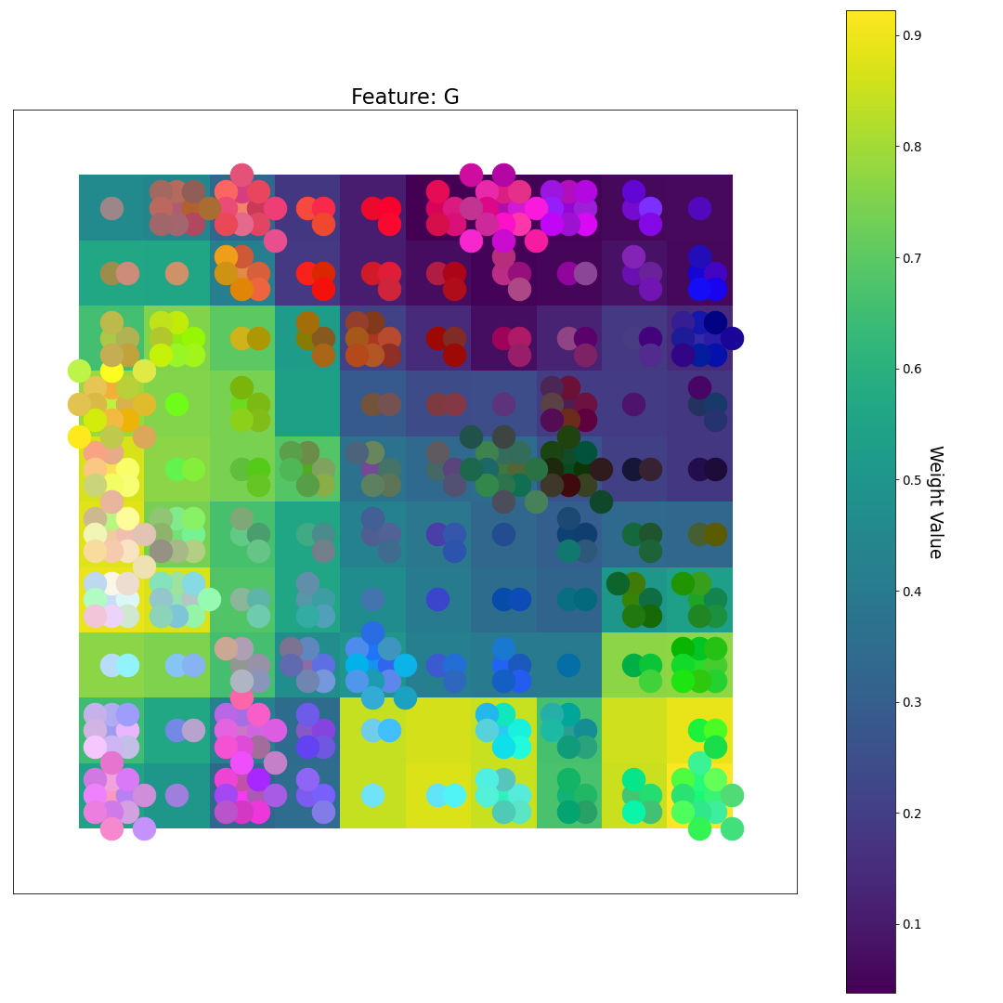
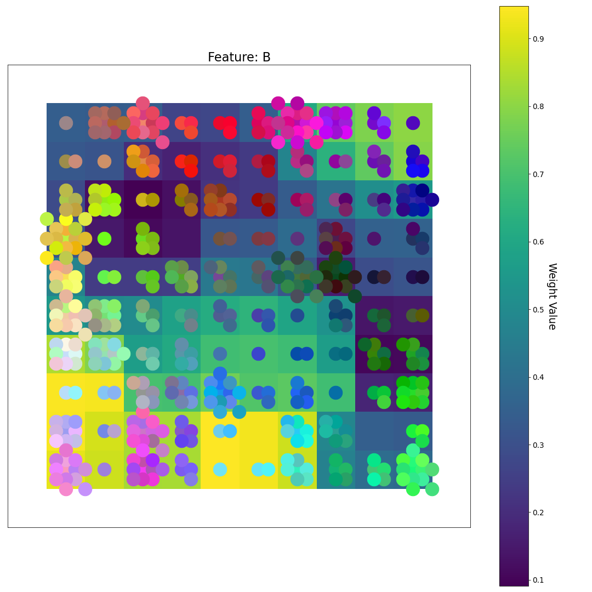
After 6 Epochs
R
U-matrix
G
Feature Plane Weight Value
B

Slide 25
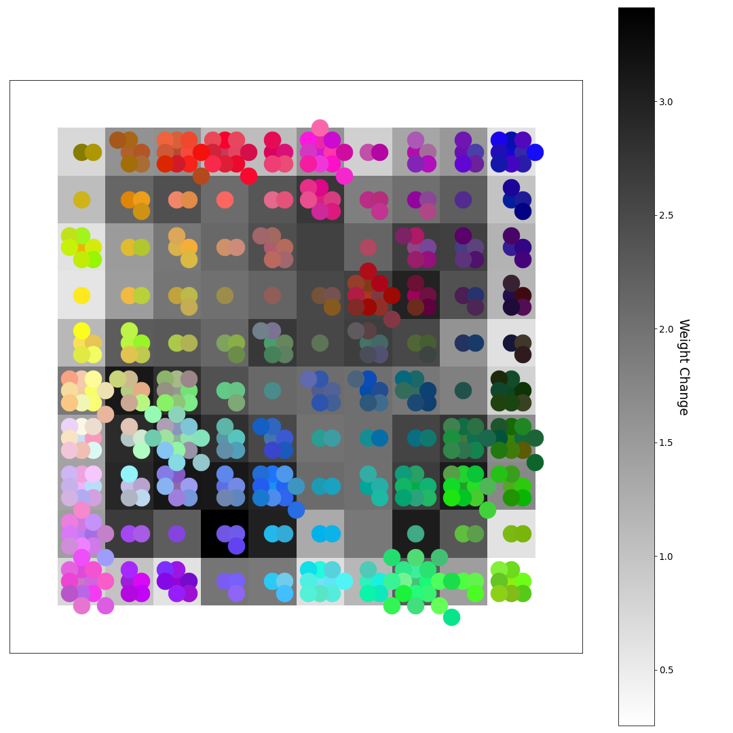
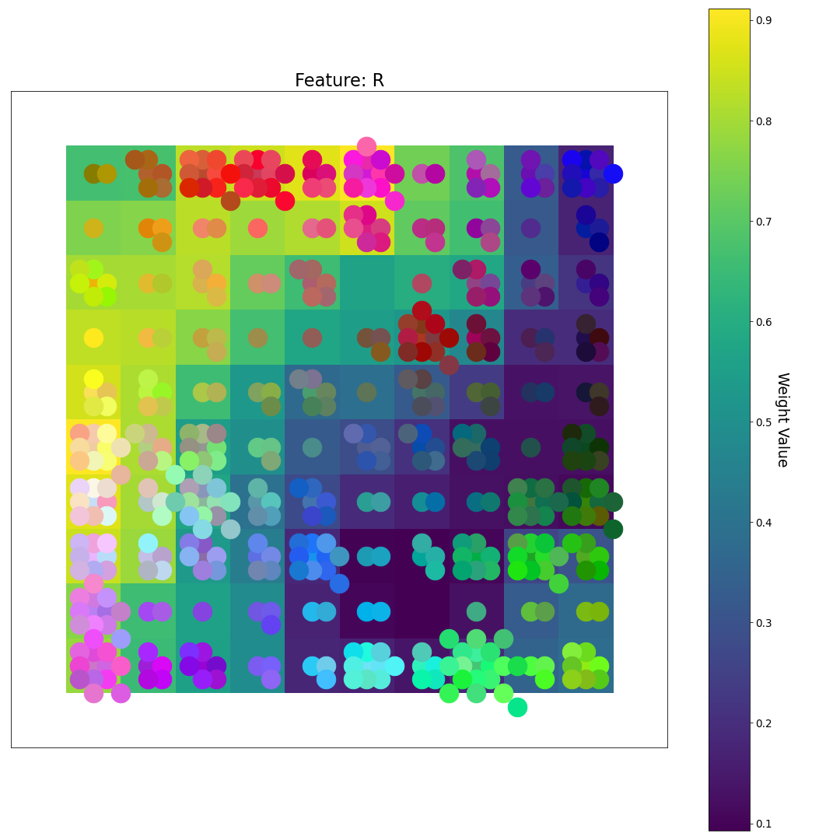
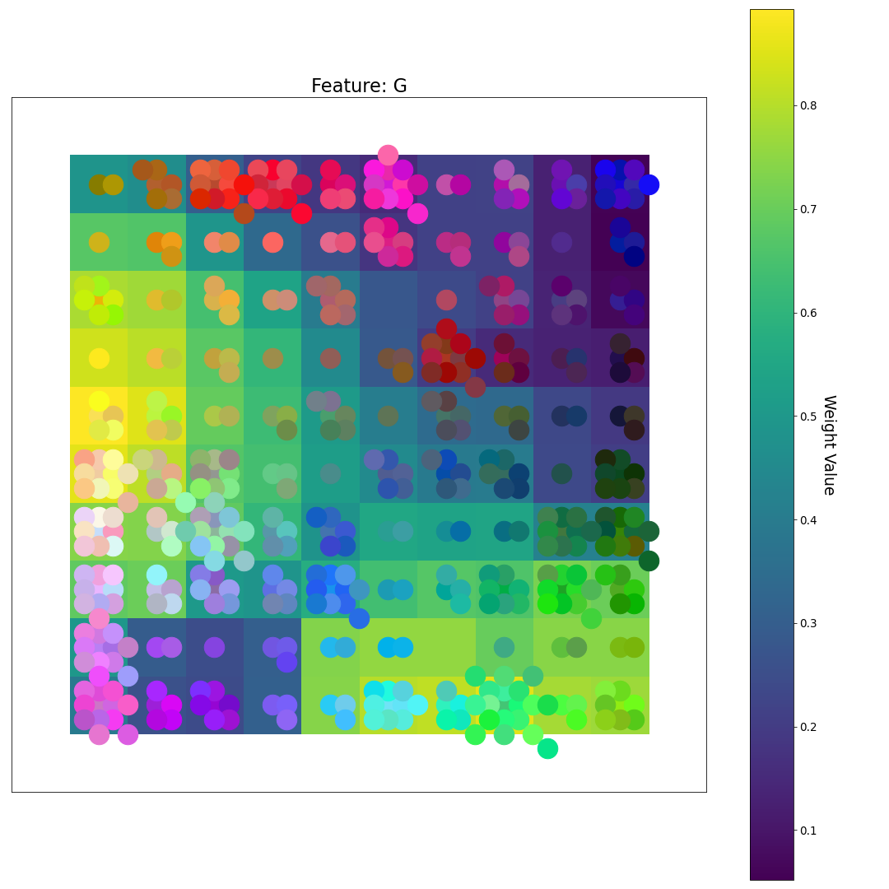
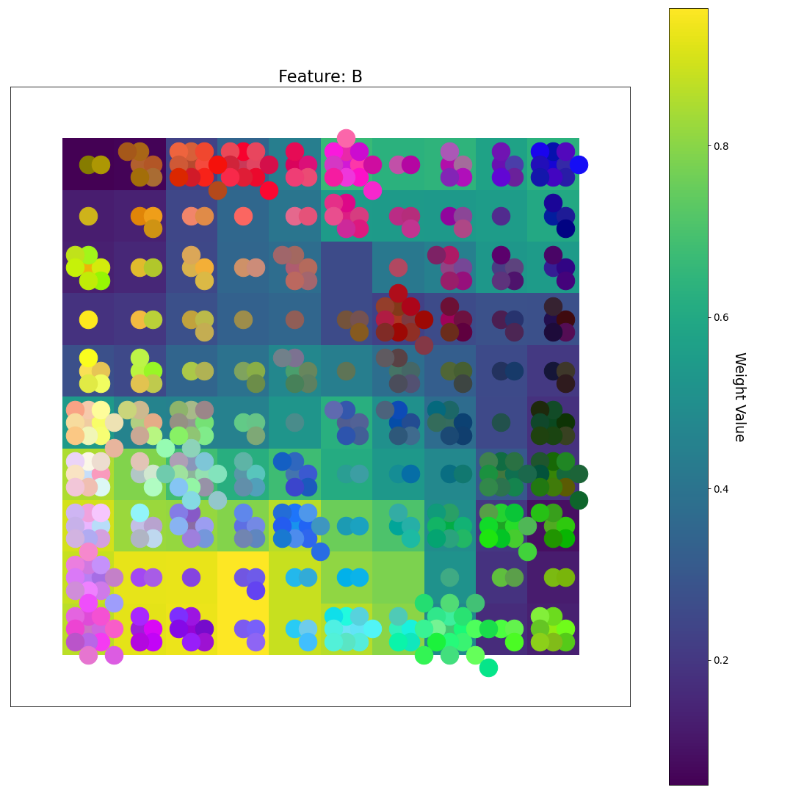
After 7 Epochs
R
What happened in the last ~2 steps?
U-matrix
G
Feature Plane Weight Value
B

Slide 26
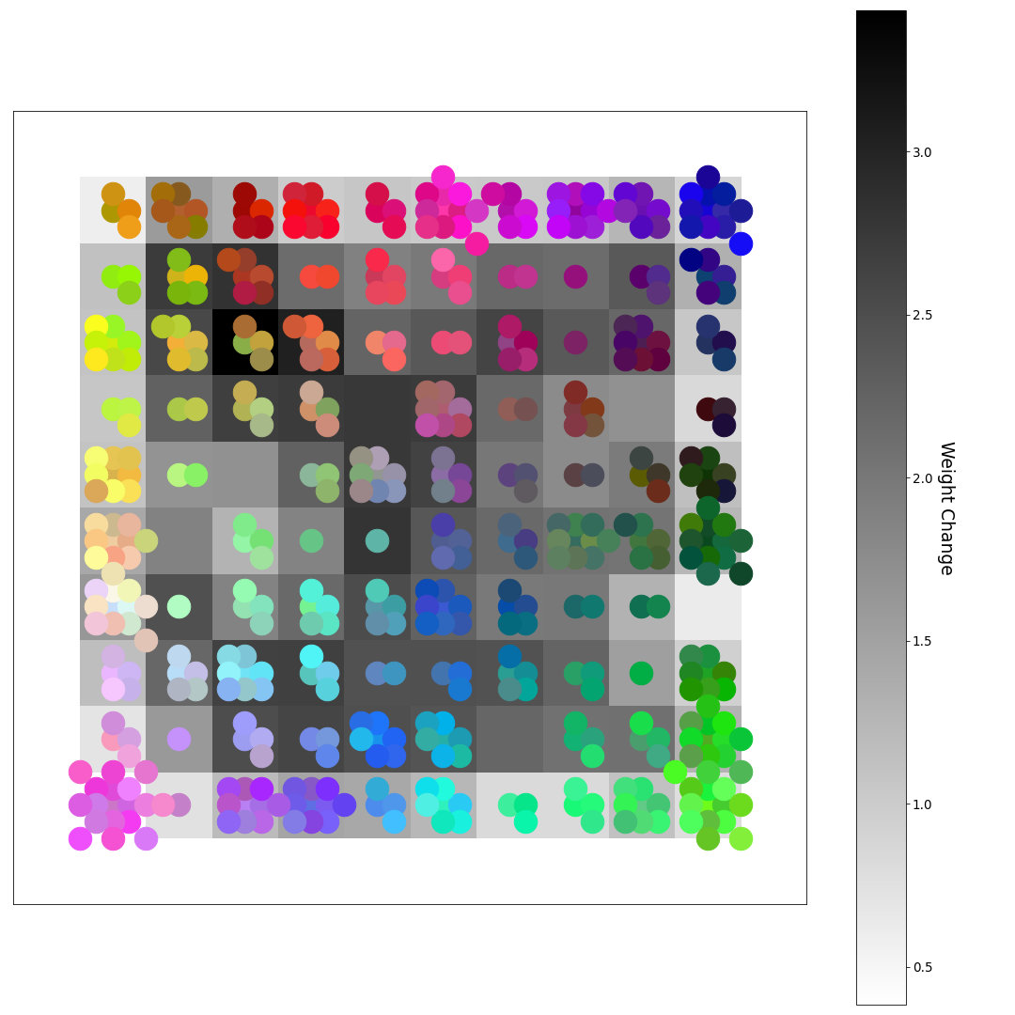
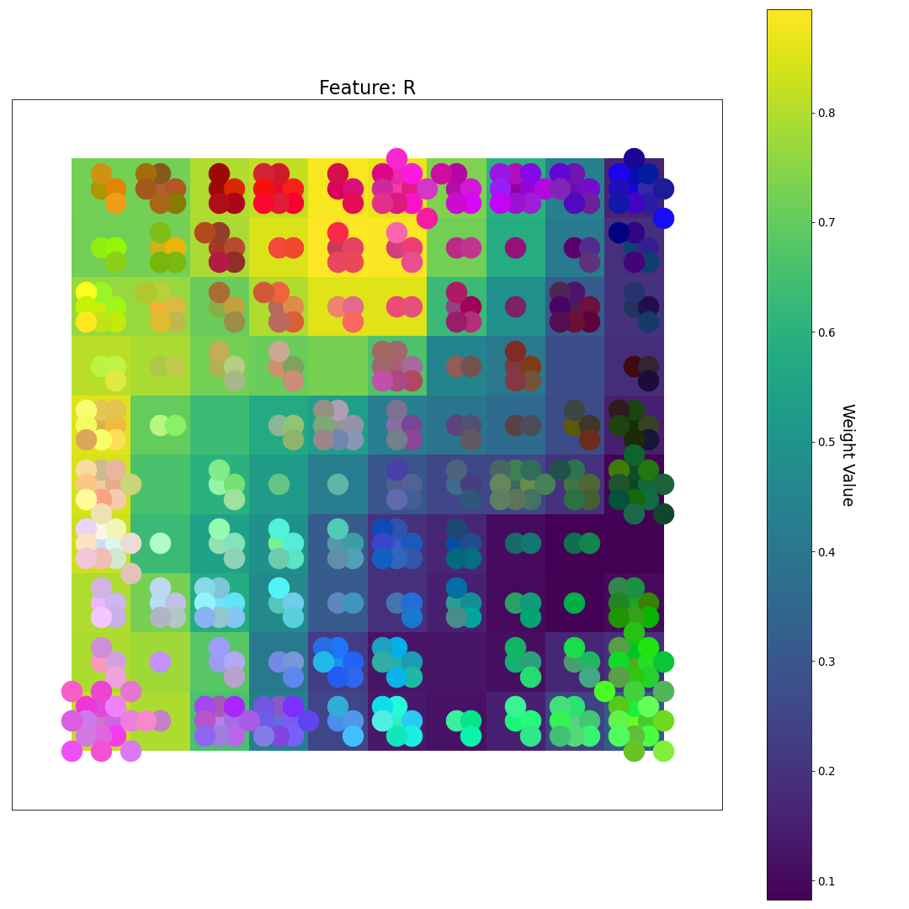
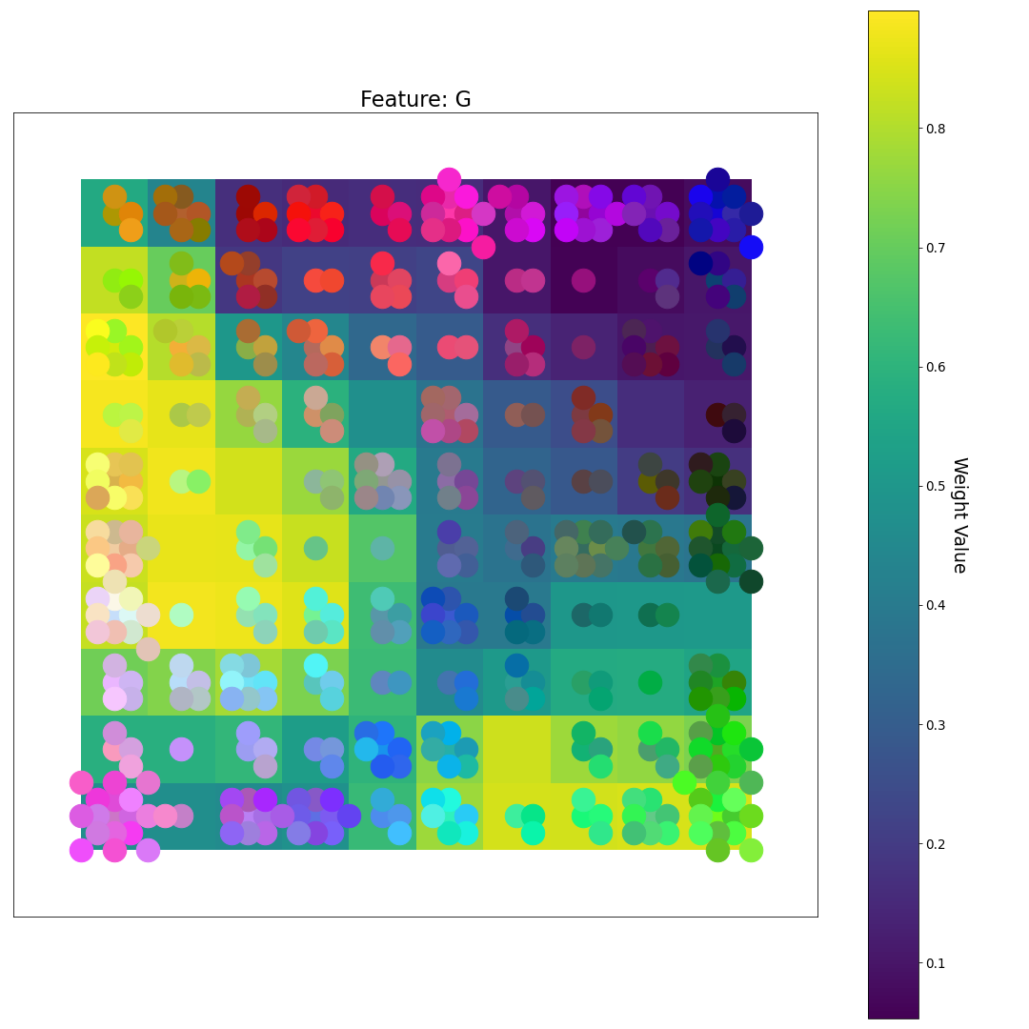
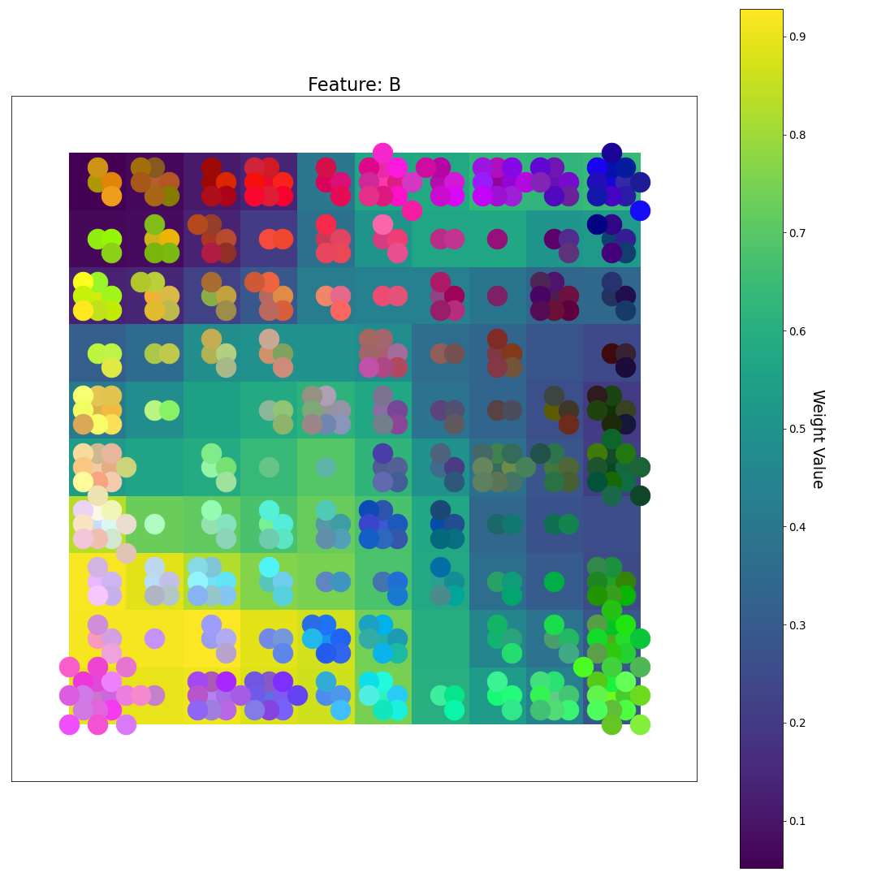
After 8 Epochs
R
U-matrix
G
Feature Plane Weight Value
B

Slide 27
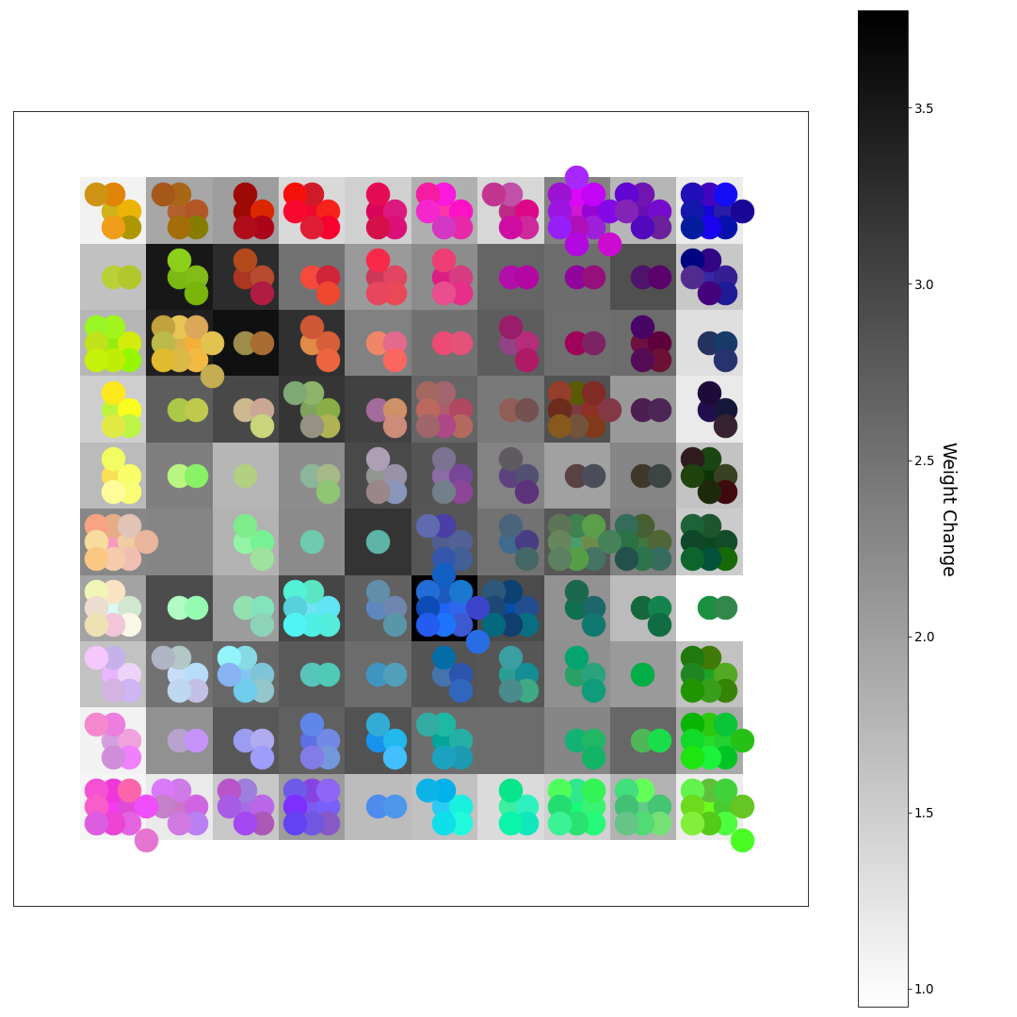

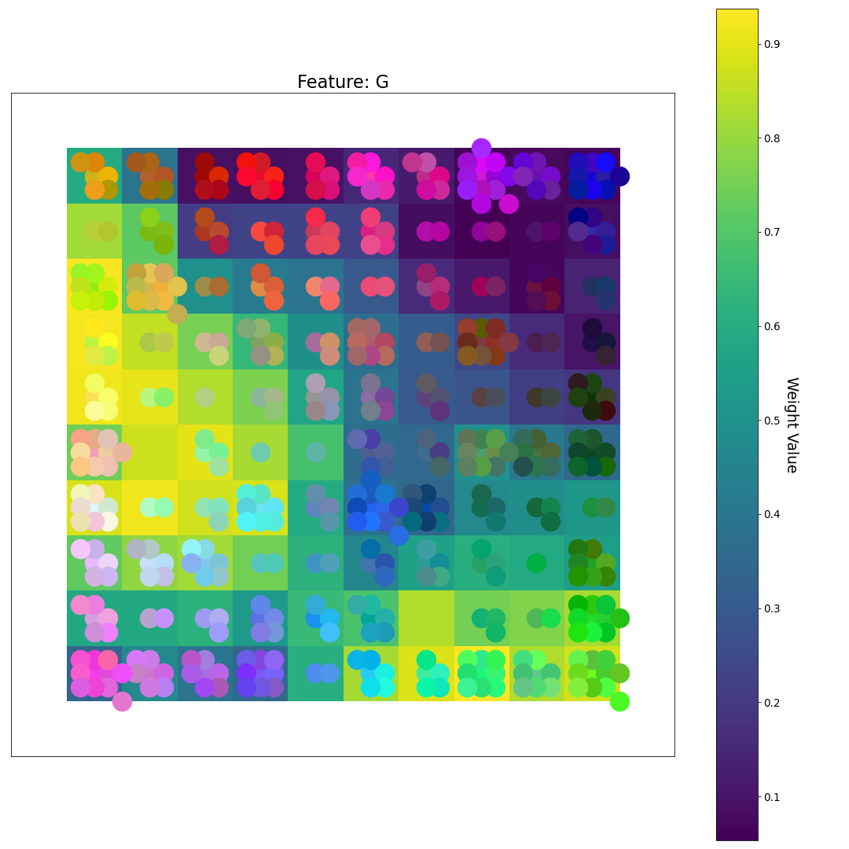
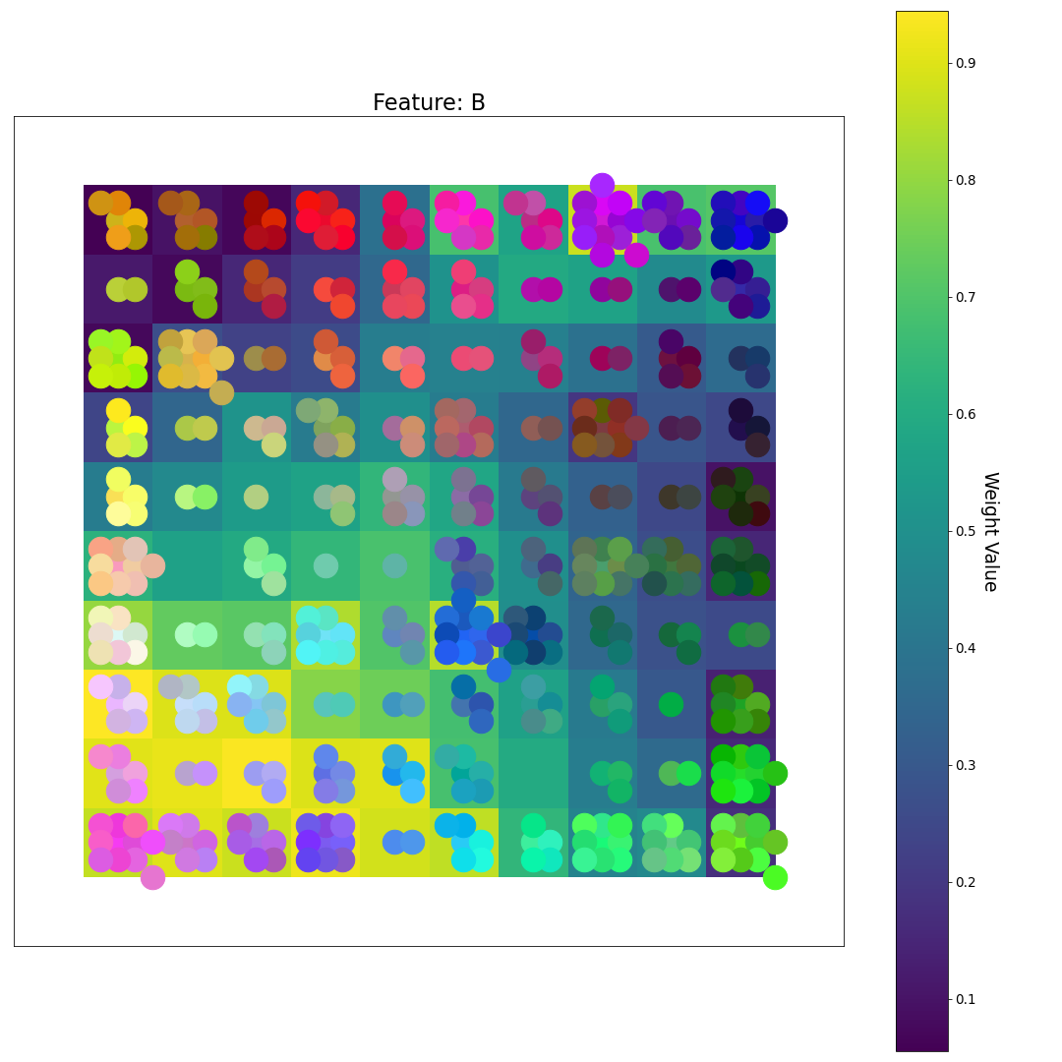
After 9 Epochs
R
U-matrix
G
Feature Plane Weight Value
B

Slide 28
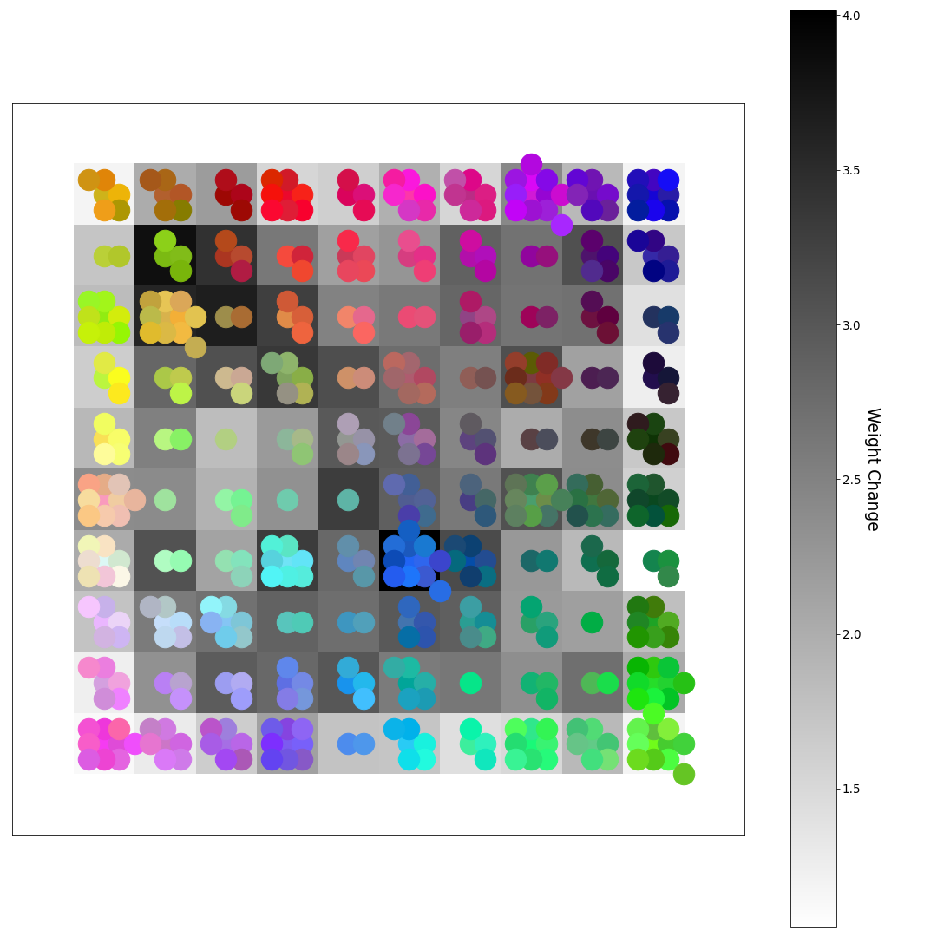

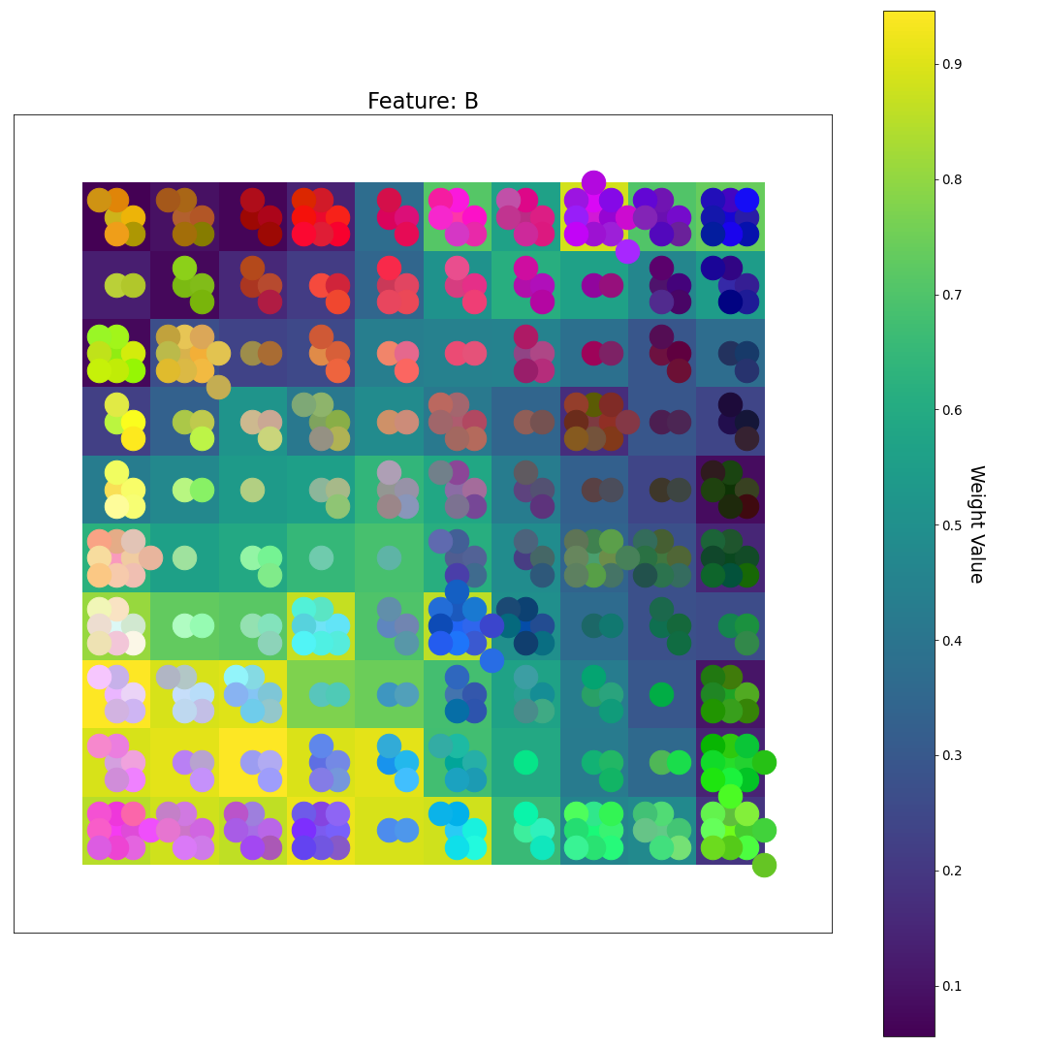
After 10 Epochs (Final Weights)
R
What do you notice now?
U-matrix
G
Feature Plane Weight Value
B

